Slide 1

DRAFT Fiscal Year 2026/27
Overall Work Program and Budget
Notes:
The Overall Work Program and Budget is the work plan that serves as a roadmap for the coming year and beyond. Each year EDCTC presents a Draft OWP for the Commission to consider the workload and direction for the coming year. The tasks within the OWP range from ongoing administrative functions to complex planning studies and efforts funded through Grants and other sources.

Slide 2
Overall Work Program Outline
Introduction and Background
Administration and Intergovernmental Coordination
Multi-Modal Transportation Planning
Project Delivery and Programming
Public Information, Outreach, and Advocacy
Budget
Notes:
The OWP includes an introduction and background of EDCTC which includes our organizational framework, our roles and responsibilities, and our partners. The final elements of the OWP include the budget, and the goals and objectives are included as an appendix for the coming year.
Next the OWP breaks out Work Elements into Four Categories including Administration and Intergovernmental Coordination.

Slide 3
ADMINISTRATION AND INTERGOVERNMENTAL COORDINATION
Notes:
Within Administration and Intergovernmental Coordination, we have seven work elements.

Slide 4
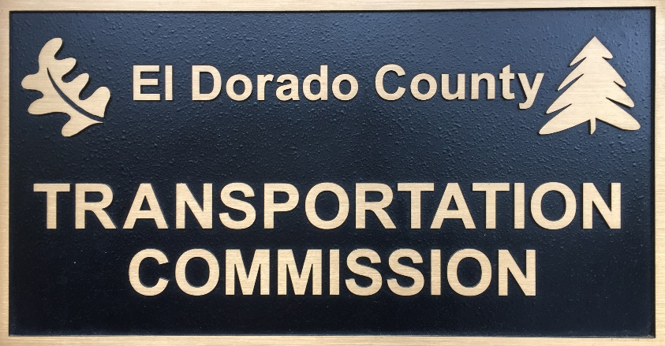
Work Element 50
AGENCY ADMINISTRATION AND MANAGEMENT: INDIRECT COSTS
OBJECTIVE:
To manage and administer the day-to-day operations of the agency that are billable as indirect under an approved Indirect Cost Allocation Plan
$541,633
Notes:
The first is Work Element 50 which is the administration and management of the Agency which includes our day-to-day operations. This effort is billed as an indirect cost consistent with our indirect cost allocation plan approved by Caltrans. Indirect costs are not specifically tied to a transportation planning project, for example indirect costs include expenses such as rent, independent audits, development of agendas and related materials, Commission meetings, and financial reports.

Slide 5
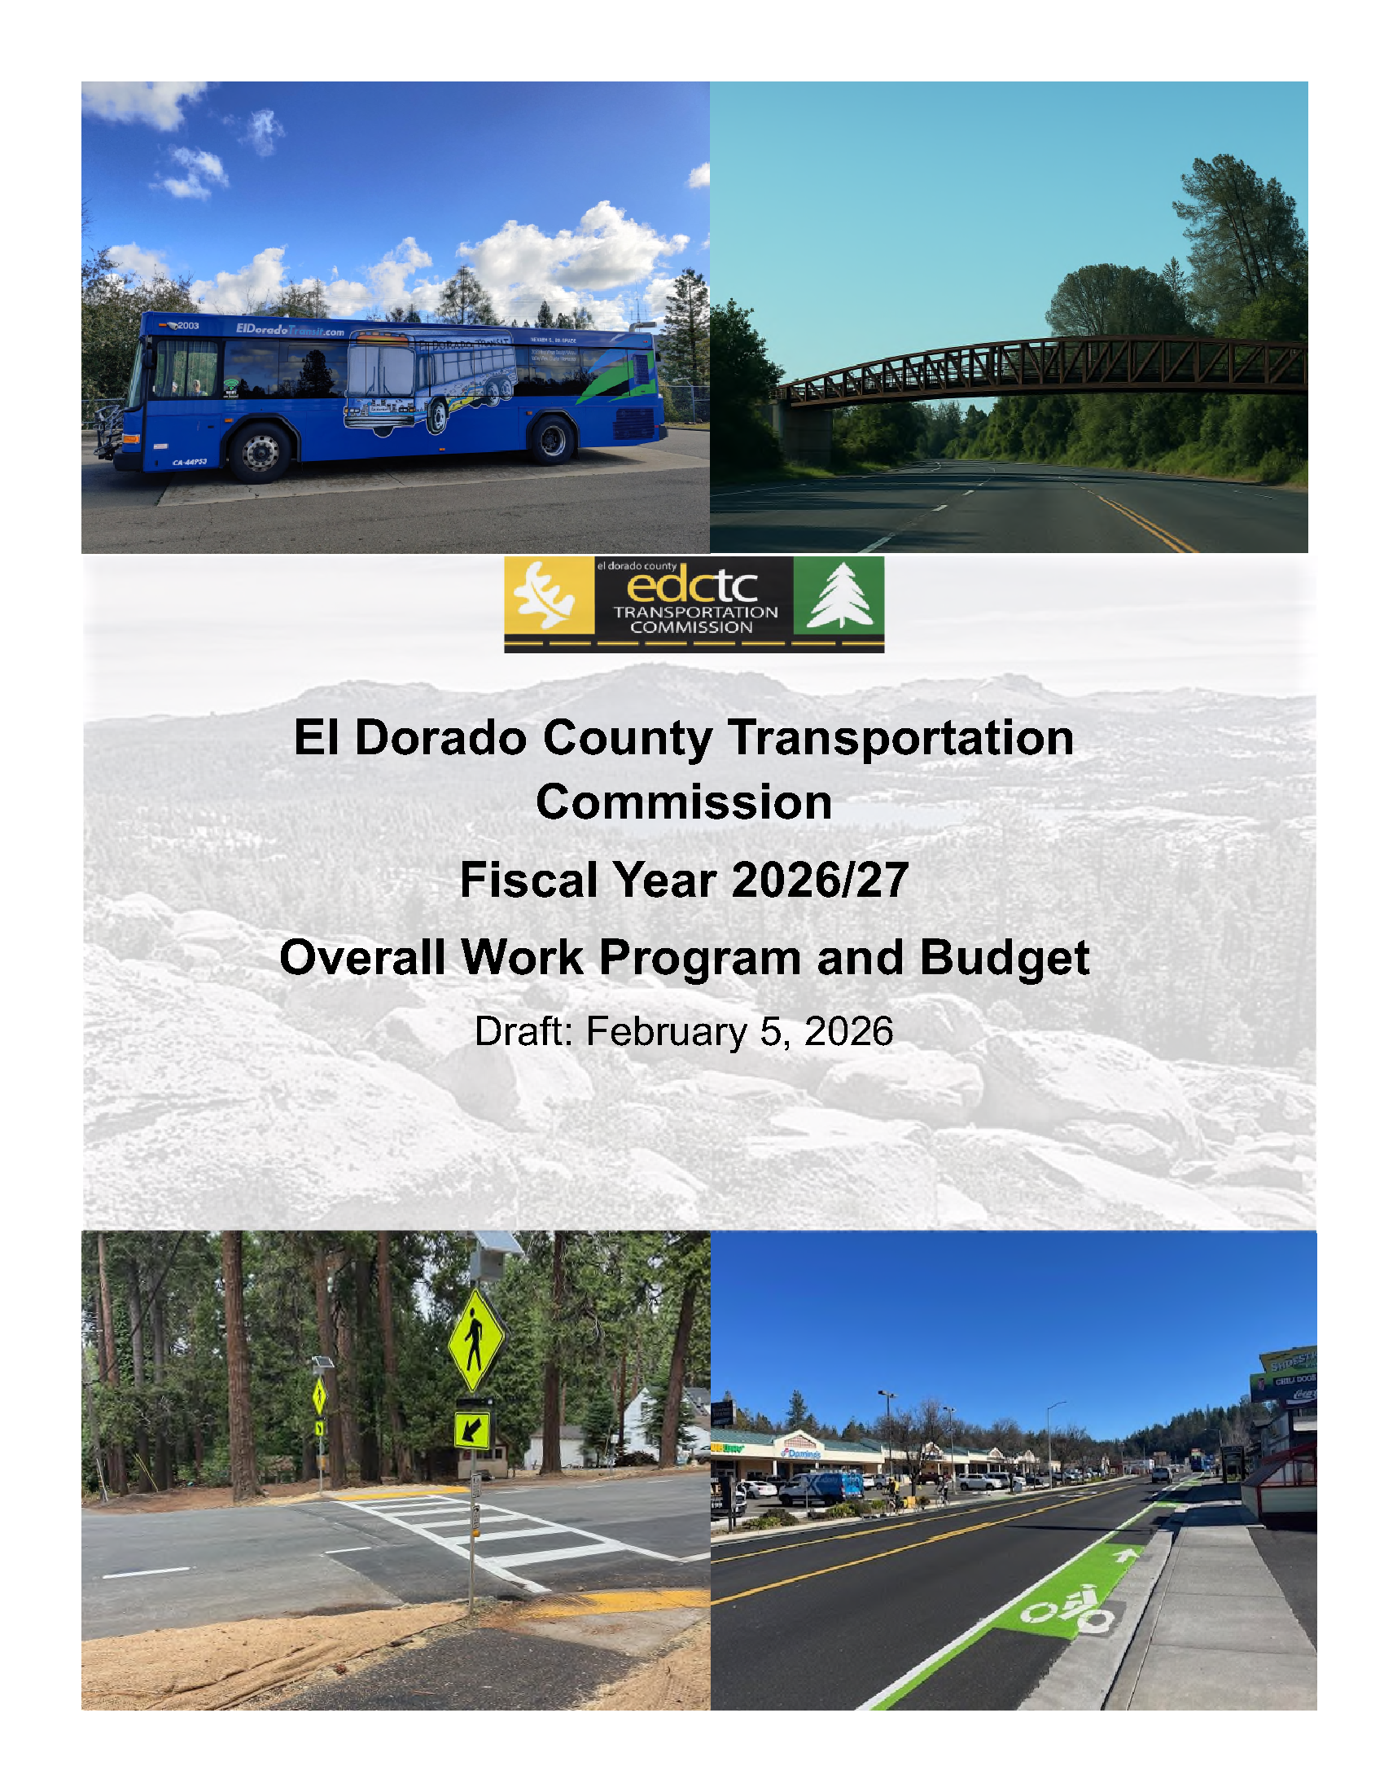
Work Element 100
ADMINISTRATION OF THE OVERALL WORK PROGRAM
OBJECTIVE:
To provide agency management and administration of the Overall Work Program that is billable to Rural Planning Assistance funds
$75,536
Notes:
Work Element 100 involves the management of the OWP for the operations of the agency.
This Element is billable to State Rural Planning Assistance Funds as one of the fundamental planning activities of EDCTC.
Tasks within this work element include quarterly reports to Caltrans and amendments made to the OWP throughout the year.

Slide 6






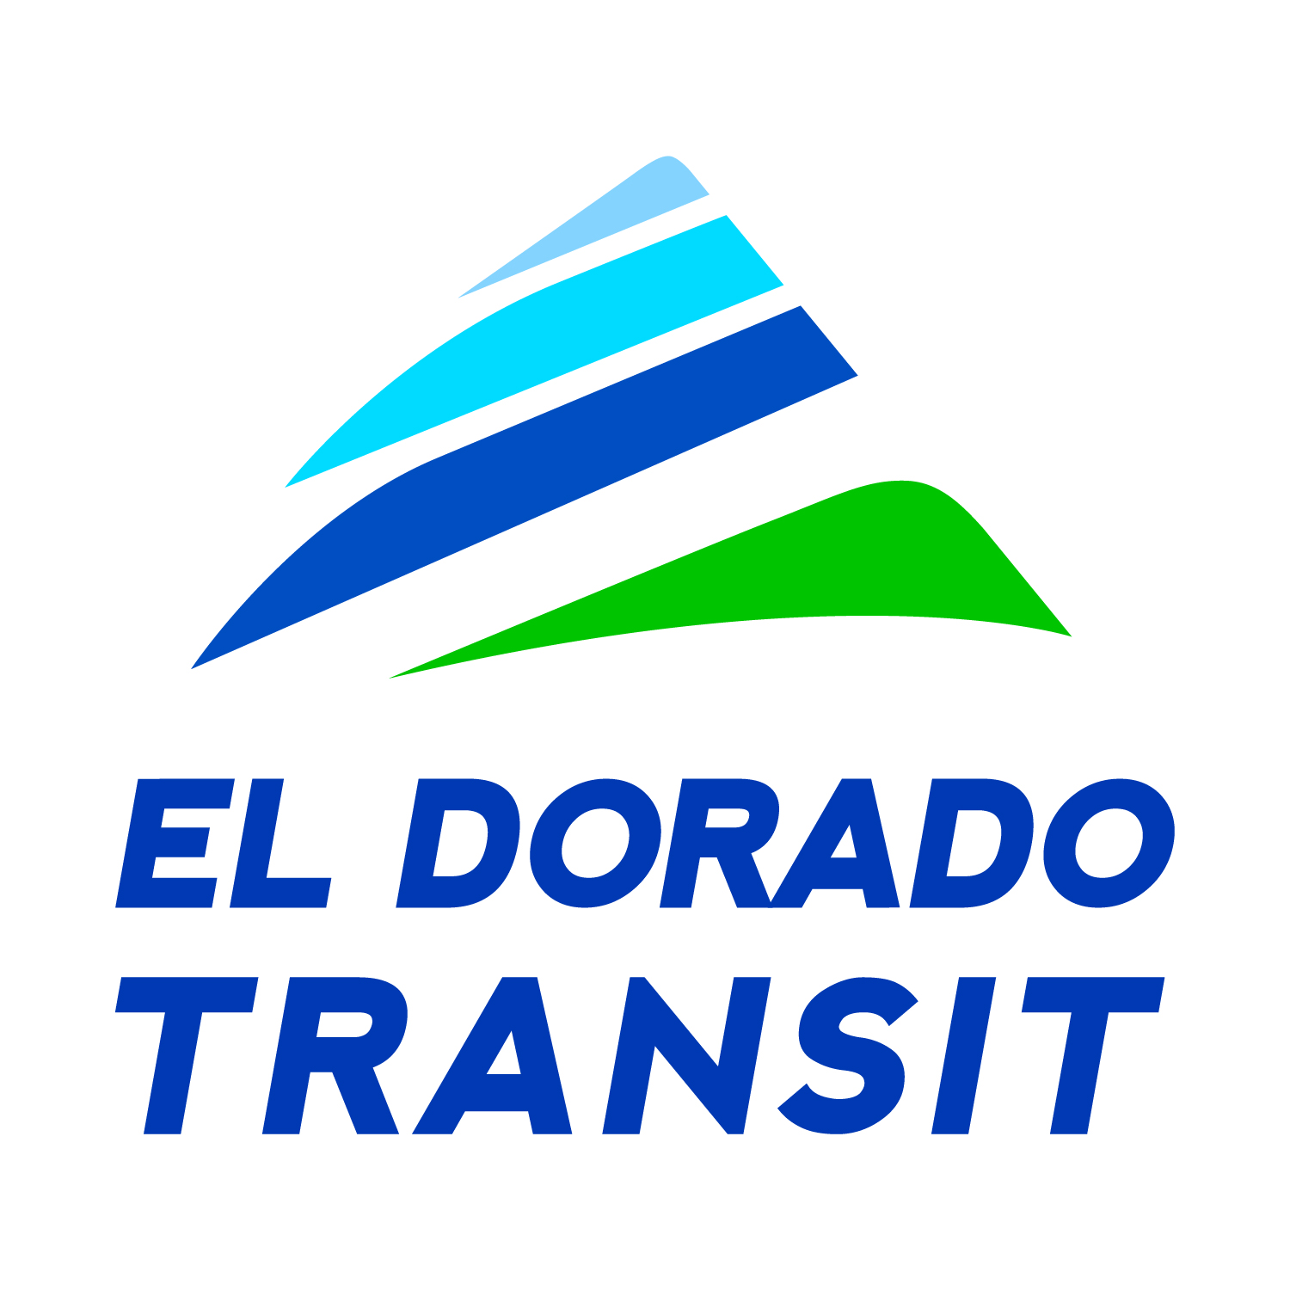

Work Element 110
INTERGOVERNMENTAL COORDINATION
OBJECTIVE:
To coordinate the efforts of the Commission with tribal, local, regional, federal, and state agencies
$187,754
Notes:
Work Element 110 Intergovernmental Coordination is a key duty of EDCTC as we are in constant coordination with all our partners to ensure our transportation planning and programming work is coordinated across all jurisdictions and serves the needs of all partners involved in delivering transportation projects and services in El Dorado County and across the broader region.
Tasks within this work element include an array of working groups, committees, and technical advisory groups, as well as one-on-one interaction with local, state and federal agencies.

Slide 7
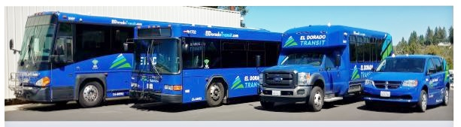
Work Element 120
TRANSPORTATION DEVELOPMENT ACT AND TRANSIT ADMINISTRATION
OBJECTIVES:
To effectively administer the Transportation Development Act, including receiving, reviewing, and approving claims for Local Transportation Funds, State Transit Assistance funds, and State of Good Repair funds
To provide staff support to the EDCTC Social Services Transportation Advisory Council
$97,887
Notes:
Work Element 120 is focused on the administration of the Transportation Development Act, or TDA, funds through programming Local Transportation Funds, State Transit Assistance funds, and State of Good Repair funds to projects and services on the West Slope.
This effort primarily focuses on our partnership with El Dorado Transit serving the public transit needs of our residents.

Slide 8
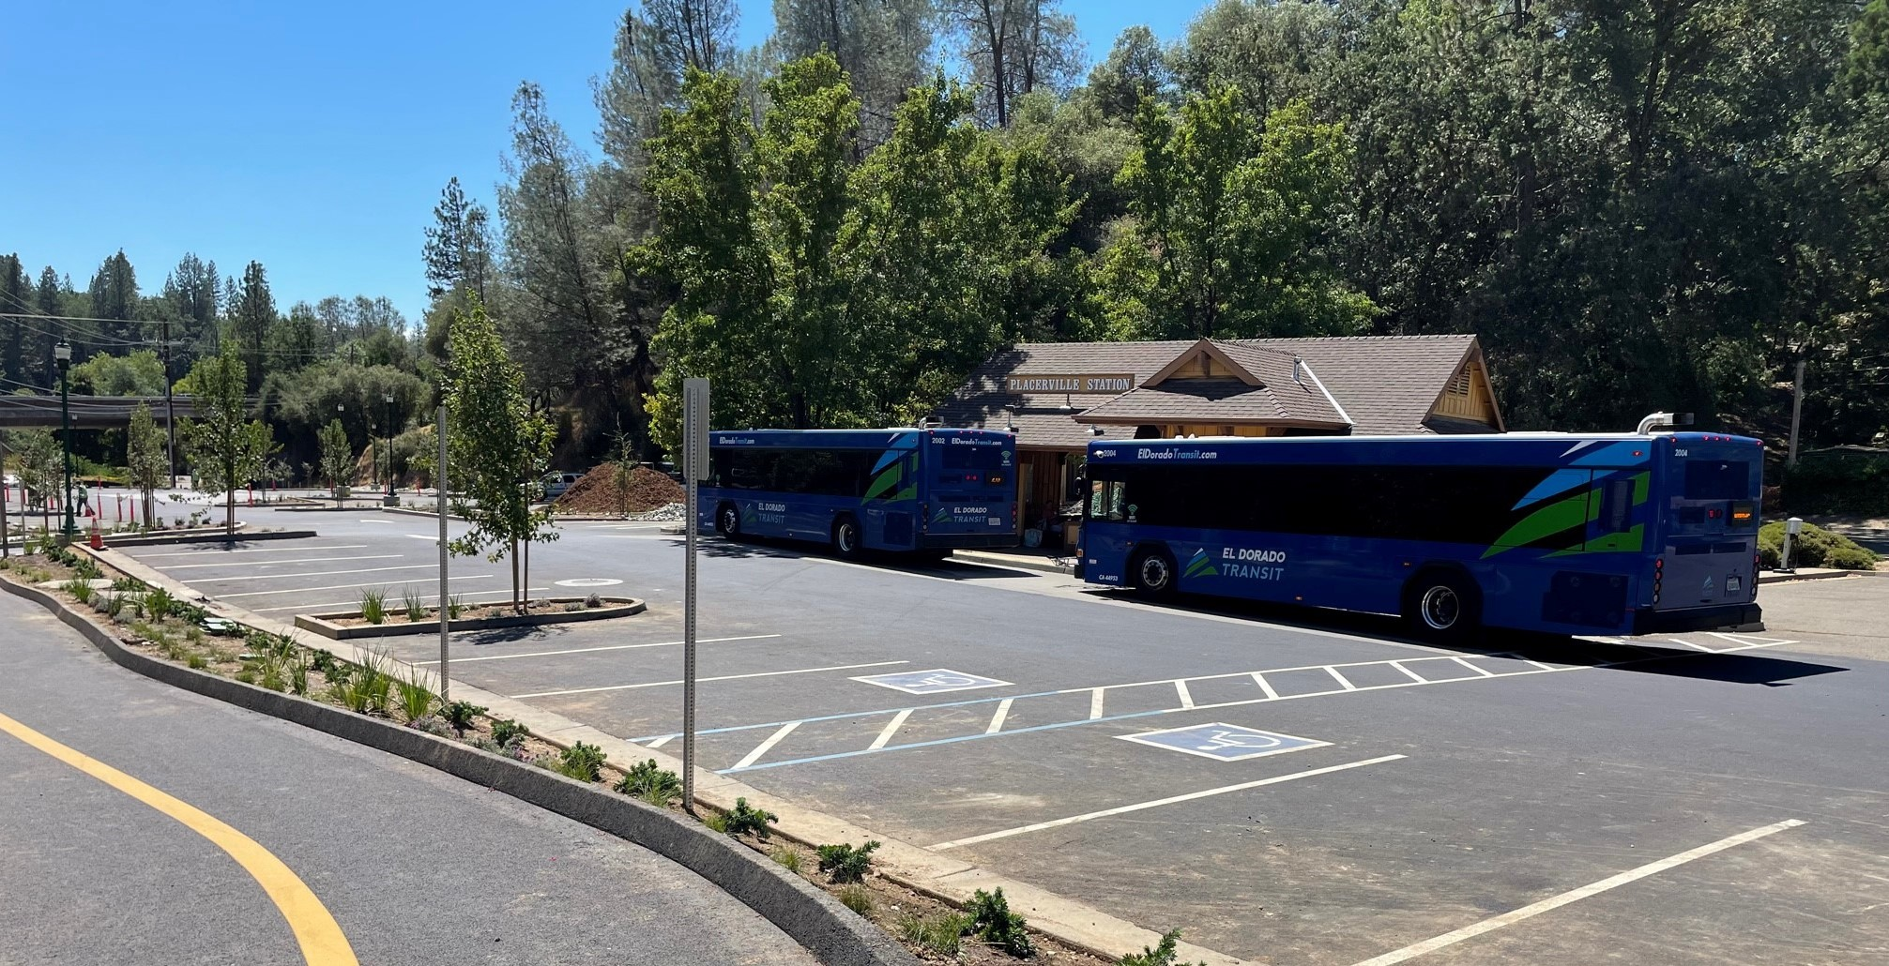
Work Element 122
TIRCP AND ZETCP ADMINISTRATION
OBJECTIVES:
Administer the Budget Act of 2023 SB 125 programs Transit and Intercity Rail Capital Program (TIRCP) & Zero Emission Transit Capital Program (ZETCP): Allocate funding, distribute to eligible agencies, and ensure expenditures comply with state law.
Maintain transparency and compliance: Post monthly transit ridership summaries online, submit annual reports to CalSTA, and work with El Dorado County Transit Authority to approve and process reimbursements.
$28,716
Notes:
Work Element 122 is in it’s third year. This Work Element is focused on administration of TIRCP and ZETCP formula funding made available to transit this year through passage of SB 125 to help restore transit mode shift across California.

Slide 9
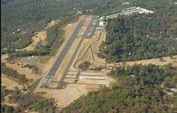
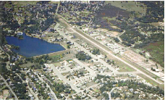
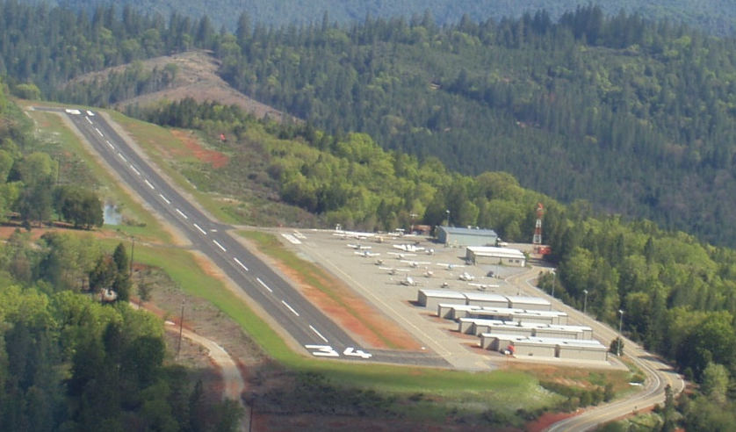
Work Element 125
EL DORADO COUNTY AIRPORT LAND USE COMMISSION
OBJECTIVES:
To administer the El Dorado County Airport Land Use Commission and related aviation system planning activities
To update and maintain the Airport Land Use Compatibility Plans for the Cameron Airpark, Placerville Airport and Georgetown Airport all under the jurisdiction of the El Dorado County ALUC
$8,164
Notes:
Work Element 125 outlines the role of EDCTC serving as the Airport Land Use Commission or ALUC for the West Slope.
This Work Element involves managing and implementing the Airport Land Use Compatibility Plans for the three airports on the west slope including the Georgetown, Placerville, and Cameron Air Park airports, to ensure safe and effective operations of the airports is not impeded by surrounding land use developments.

Slide 10
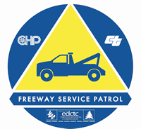
Work Element 130
EL DORADO COUNTY
FREEWAY SERVICE PATROL
OBJECTIVE:
To manage and oversee the operation of a Freeway Service Patrol along US Highway 50 within El Dorado County
$207,111
Notes:
The last work element under Administration and Intergovernmental Coordination is Work Element 130, the Freeway Service Patrol
EDCTC manages the FSP contract, currently with Extreme Towing, for the motorist aid service operating along US 50 from the County Line to Greenstone Road.

Slide 11
MULTI-MODAL
TRANSPORTATION PLANNING
Notes:
The next Work Program category is Multi-Modal Transportation Planning which includes two work elements.

Slide 12
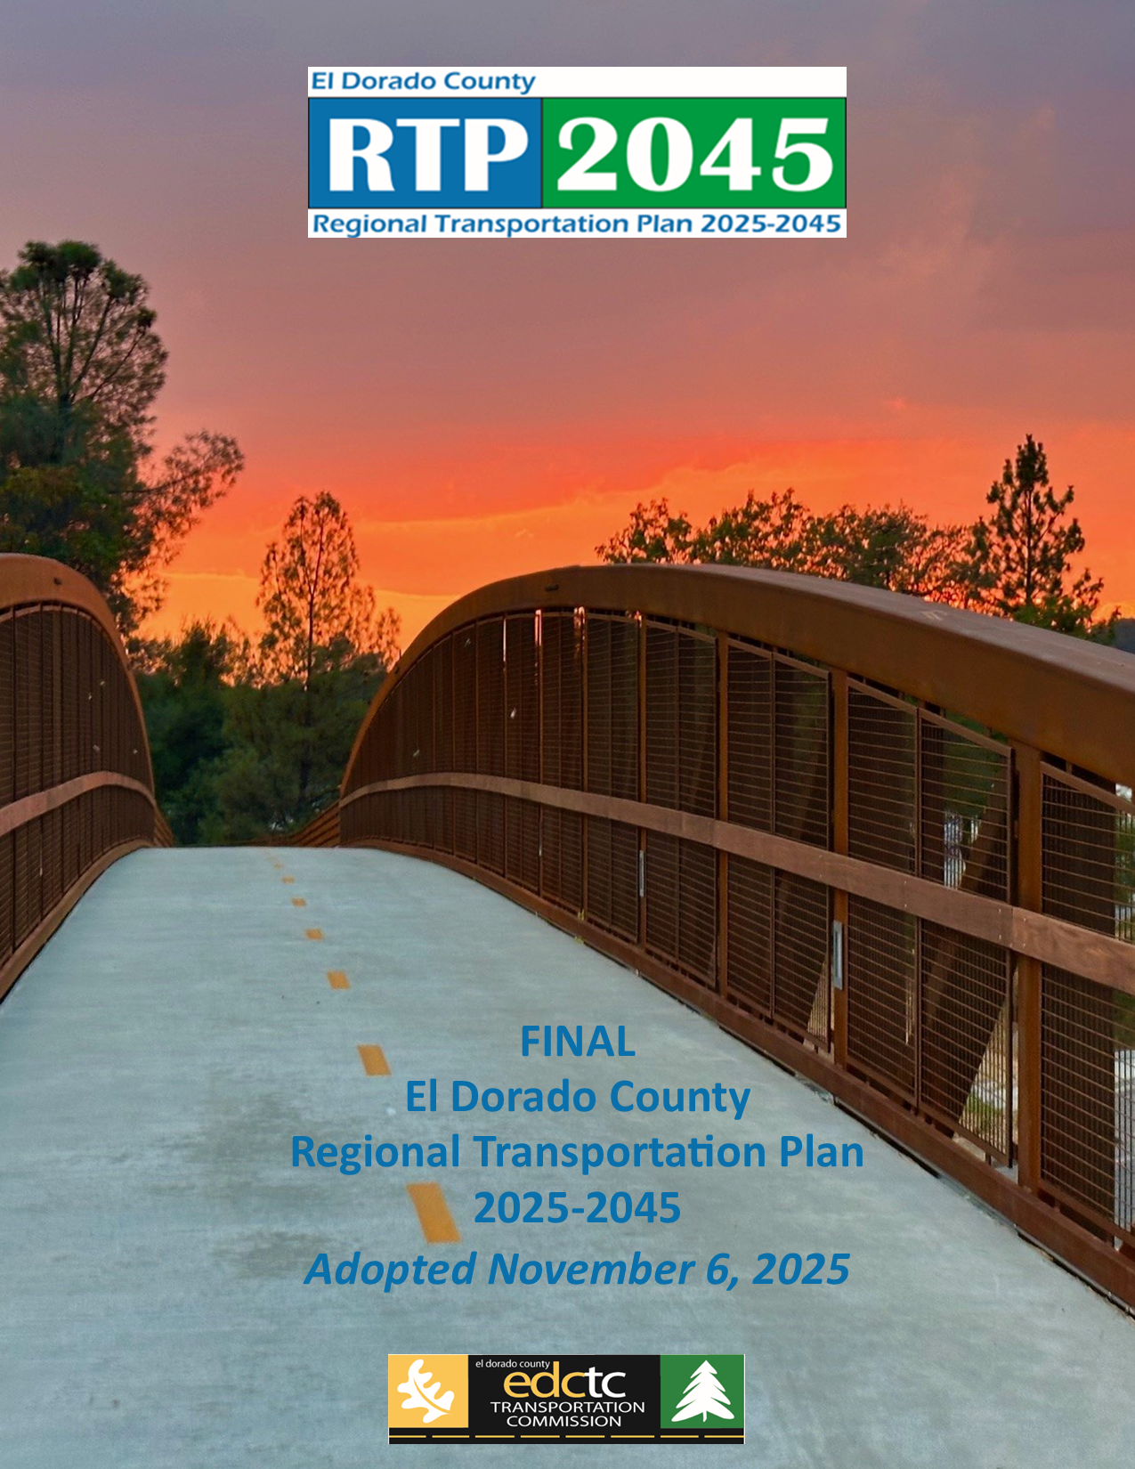
Work Element 200
REGIONAL TRANSPORTATION PLAN
OBJECTIVE:
To implement the EDCTC 2025-2045 Regional Transportation Plan and coordinate with partner agencies to integrate the RTP into SACOG’s Metropolitan Transportation Plan
$260,809
Notes:
Work Element 200 is the RTP which is our twenty-year transportation plan updated every 5 years.
We are in full swing of the 2025-2045 RTP this current fiscal year and will wrap up by the end of the calendar year.
In order for a transportation project to be eligible to secure or compete for federal or state transportation funding, it must be included in this fiscally constrained 20-year plan.
The RTP is integrated into the SACOG Metropolitan Transportation Plan Sustainable Community Strategies as the El Dorado County component of the six-county regional plan.

Slide 13
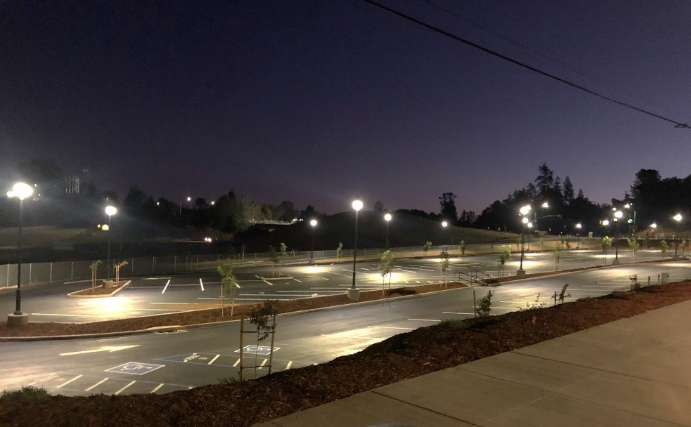
Work Element 221
TRANSIT PLANNING
OBJECTIVES:
To coordinate with the El Dorado County Transit Authority (EDCTA) on the development and implementation of transit-related planning efforts
To coordinate with the EDCTA on the implementation of state and federal grant programs that are not administered through the Transportation Development Act
$40,930
Notes:
Work Element 221 outlines our close and strong partnership with El Dorado Transit planning for transit services and facilities.
El Dorado Transit has done a remarkable job restoring service post-covid pandemic which greatly impacted ridership across all transit operators nationwide.
We enjoy a relationship of strong collaboration, open dialogue, and mutual respect with El Dorado Transit and look forward to continued efforts to improve transit and bring new innovative transit options to our residents in the coming years.

Slide 14
PROJECT DELIVERY AND PROGRAMMING
Notes:
The next category of work elements is Project Delivery and Programming comprised of three work elements.

Slide 15
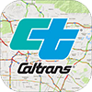


Work Element 300
STATE AND FEDERAL PROGRAMMING
OBJECTIVES:
To deliver projects through the state funding programs: State Transportation Improvement Program (STIP), Road Repair and Accountability Act of 2017 (Senate Bill 1), the Regional Transportation Improvement Program (RTIP), and Interregional Transportation Improvement Program (ITIP)
To secure federal discretionary funding available through the current surface transportation bill.
Work directly with SACOG, the City of Placerville, and El Dorado County to secure and program federal funds.
$207,711
Notes:
The first being Work Element 300 State and Federal Programming which is a fundamental purpose of EDCTC.
This element involves the ongoing planning and prioritizing of projects, identifying funding opportunities, and ultimately programming of funds to our partner agencies to deliver transportation projects and services.

Slide 16
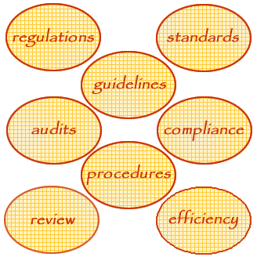
Work Element 310
TRANSPORTATION PROJECT DELIVERY AND OVERSIGHT
OBJECTIVES:
To ensure that projects using state and federal transportation funds use those funds in a timely and cost-effective manner and meet the requirements of funding programs
To coordinate with local and tribal jurisdictions to develop projects that meet specific federal program guidelines
$186,681
Notes:
Work Element 310 is the Transportation Project Delivery and Oversight which involves our role in overseeing project delivery for projects which EDCTC has programmed state or federal funding.
As the agency responsible for administering state transportation funding, it is our duty to make sure the funds are used appropriately, in a timely manner, and for projects which serve all transportation needs across modes, serve all users of the system and enhance the safety, operation, and useful life of the transportation system.

Slide 17
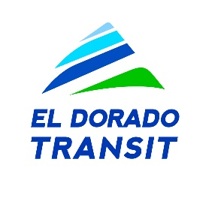




Work Element 330
ACTIVE AND ALTERNATIVE TRANSPORTATION PROGRAMS
OBJECTIVE:
To promote projects that will maintain, improve, and expand public transit systems, and active and alternative modes of transportation, such as carpooling, ridesharing, bicycling, and walking
Additional measures include compressed work weeks and telecommuting
$108,347
Notes:
Work Element 330 is our Active and Alternative Transportation Programs which involves our role in promoting active and alternative modes such as cycling, walking, carpooling, and transit.

Slide 18
PUBLIC INFORMATION, OUTREACH, AND ADVOCACY
Notes:
The fourth and final category of work elements is our Public Information, Outreach, and Advocacy

Slide 19
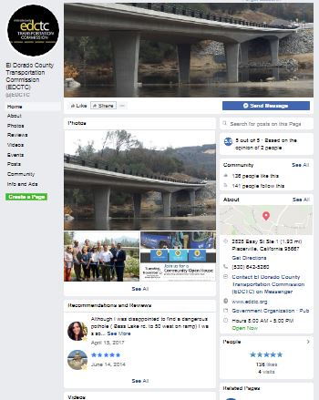
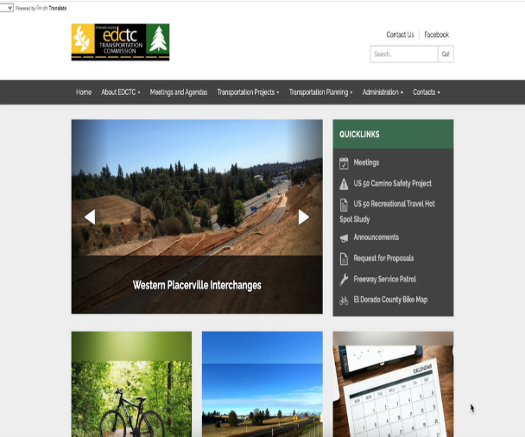
Work Element 400
PUBLIC EDUCATION AND OUTREACH
OBJECTIVE:
To support EDCTC’s project delivery, planning,
and consensus-building programs by providing information on transportation and related issues, and by seeking input on these issues from interested parties
$55,849
Notes:
Work Element 400 is fundamental to our planning function as it focuses on coordination and consultation with the public, interested parties, focus groups, the business community and other stakeholders to ensure they all have ownership in the process, the plans developed, and ultimately the projects delivered.
This is an area which is ever evolving and continues to present us with new opportunities through advances in technology, virtual interface tools, and non-traditional means of engagement.

Slide 20
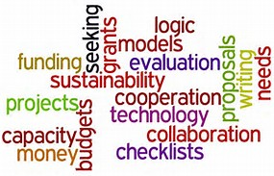
Work Element 410
TRANSPORTATION ADVOCACY PROGRAM
OBJECTIVE:
To obtain discretionary state and federal transportation funds for highway and road improvements, transit operations, active and alternative transportation improvements, and other miscellaneous transportation projects, programs, and plans
To participate in the legislative process to benefit the transportation interests of El Dorado County and the City of Placerville
$134,256
Notes:
The final work element is 410 which is our Transportation Advocacy Program which includes our efforts to secure discretionary state and federal transportation funding for various projects.
This work element includes events such as Cap to Cap but also more meaningful efforts working directly with local, regional, and state leaders and legislators to share our transportation story, express our needs clearly, and advocate strongly.
I anticipate this work element will be critical this coming year as the new federal administration begins to shape the next surface transportation bill.

Slide 21
BUDGET
Notes:
Next we have a summary of the budget revenue and expenditures and Karen Thompson is going to present that information.

Slide 22
2026/27
Draft Budget Revenues

Slide 23
2026/27
Draft Budget Expenditures

Slide 24

Next Steps
Submit Draft OWP and Budget to Caltrans – February
Respond to Caltrans comments and recommendations – April
Schedule Ad Hoc Budget Subcommittee meeting – April
Present Final OWP and Budget to EDCTC – May
Submit Final OWP and Budget to Caltrans – May
Notes:
Next, we will be submitting the Draft OWP to Caltrans, pending your direction today.
We then will respond to any comments received by Caltrans followed by an
Ad Hoc Budget Subcommittee meeting in April.
The Final OWP will be presented to your Commission in May followed immediately by final submission to Caltrans.

Slide 25
Questions?

