Slide 2
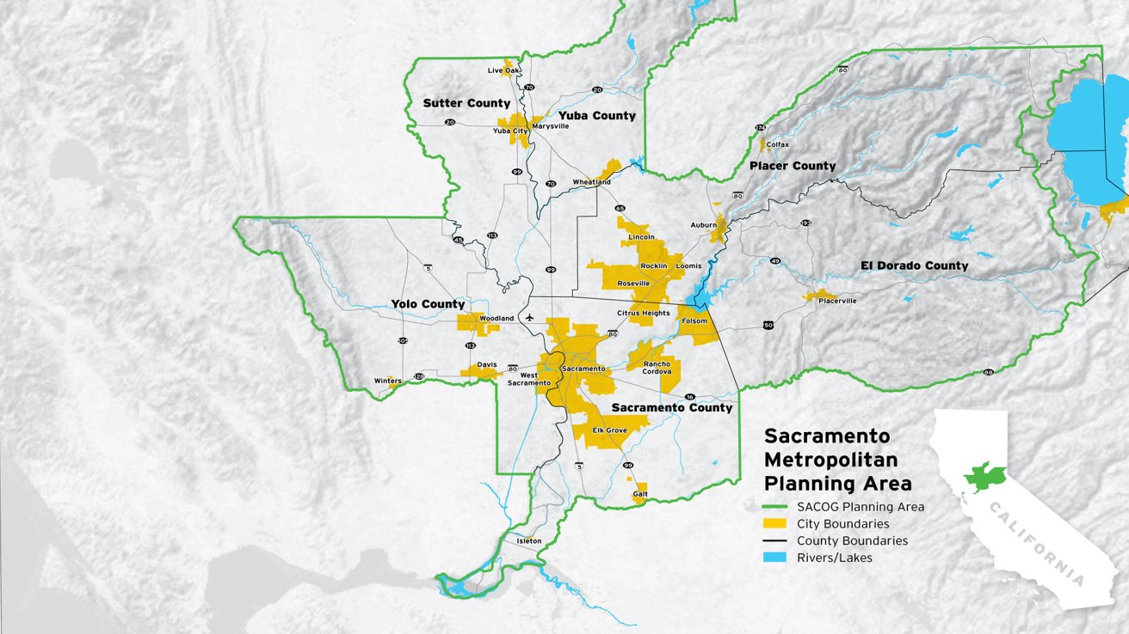
Notes:
SACOG is where local government leaders across the region come together to advance the goals of economic prosperity, connected communities, and vibrant places. SACOG works with its 6 counties and 22 cities to solve challenges that are too big for any one jurisdiction to solve on its own. SACOG plays a central role in transportation infrastructure planning and funding assistance for cities, counties, transit operators, and other entities responsible for providing for the travel needs of the region’s residents.
One of SACOG’s main jobs, designated by the federal government, requires SACOG to maintain a regional transportation plan that must be updated every four years in coordination with each local government.

Slide 3
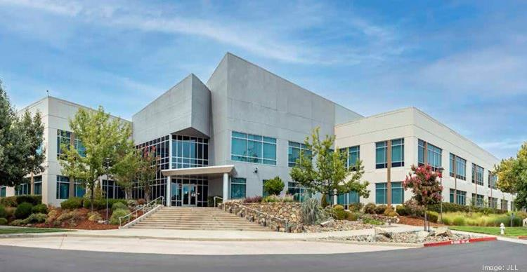
Triple Bottom Line Framework
Equity
Economy
Environment
Notes:
The triple bottom line framework will use equity, economy, and environment, to shape the discussions and strategies for the 2024 Blueprint. This plan aims to come together around a collective vision to advance economic prosperity, support environmental health and resiliency, and promote equity through reducing transportation and housing disparities by race, ethnicity, income, and ability.

Slide 4
What We’ve Heard
Themes From Outreach & Engagement

Slide 5
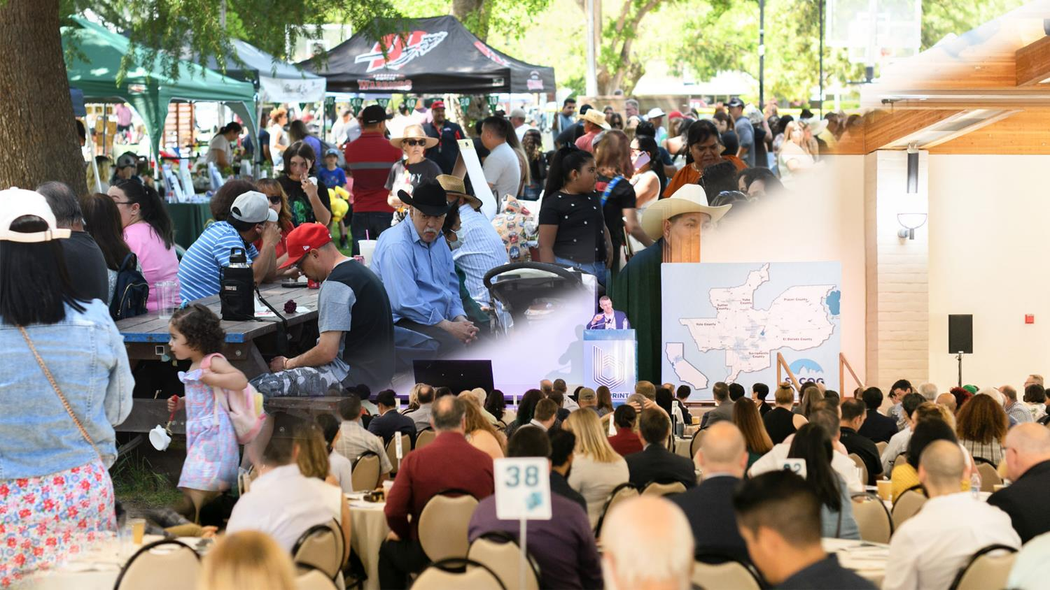
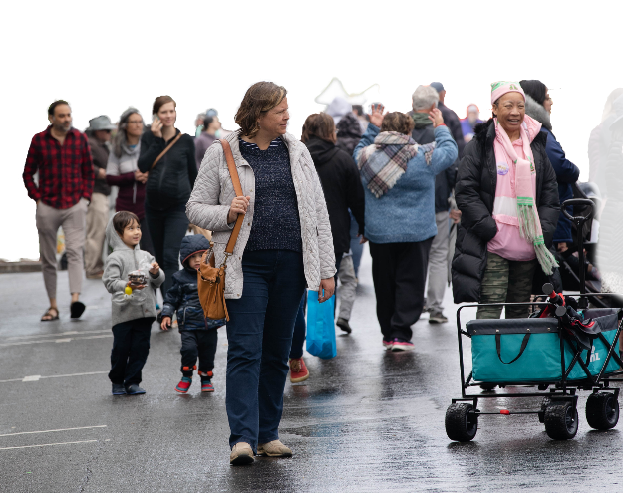
Outreach & Engagement

Slide 7
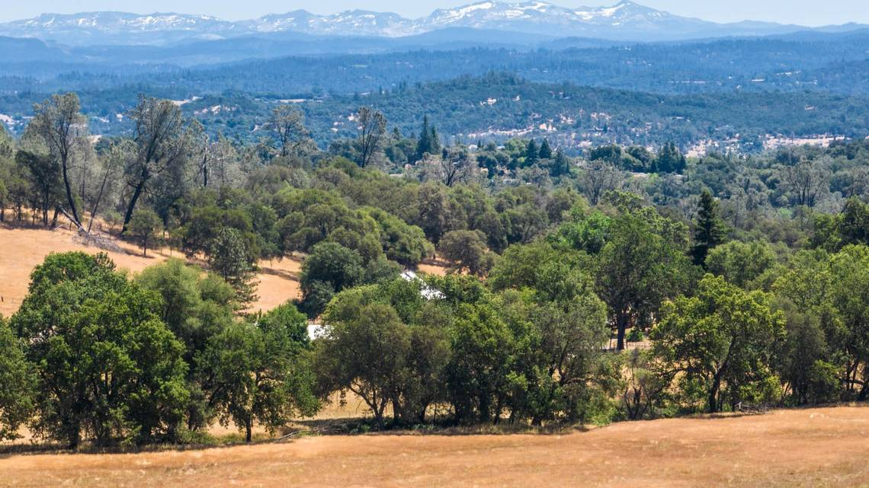
“Designing two ways out not only ensures safety during evacuations but also helps ease traffic congestion during peak times.”
2023 SACOG Focus Groups

Slide 8
Provide Housing Options for all Incomes and Life Stages
2023 SACOG led Survey

Slide 9
What We’ve Learned
Technical Analysis

Slide 10
Average Annual Population Growth

Slide 11
Growth Forecast
 | ​ | Region |  | EDCTC
 |  | 2020 | ​Change, ‘20-’50 | 2020 | ​Change, ‘20-’50
 | ​Population | 2,500,000 | +600,000 | 163,100 | +17,500
 | ​Jobs | 1,170,000 | ​+260,000 | 51,500 | +11,100
 | Housing Units | 945,000 | +278,000 | 67,000 | +8,300
Notes:
The policy frameowkr also included a regional growth forecast, which will be used to forecast the 2035 and 2050 growth for the 2024 Blueprint.

Slide 12
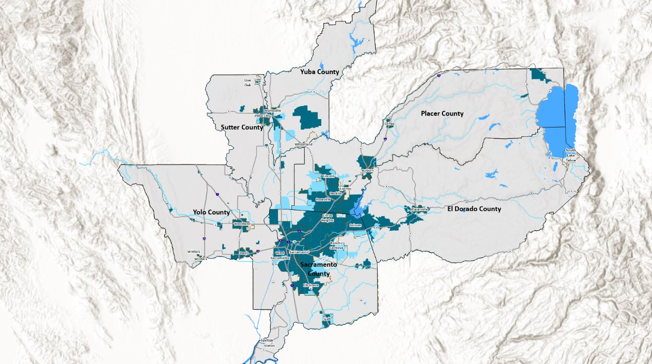
Growth Footprint
Notes:
Dark blue in chart shows approximate housing growth in “infill” or existing communities

Slide 13
Where We’re Going
Transportation and Regional Programs

Slide 14
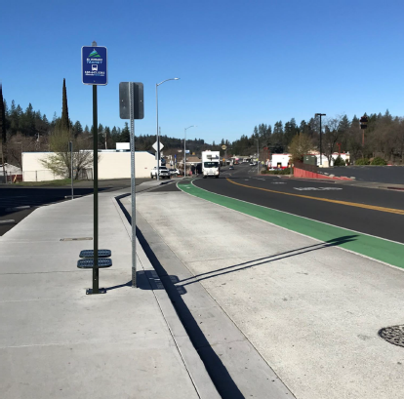
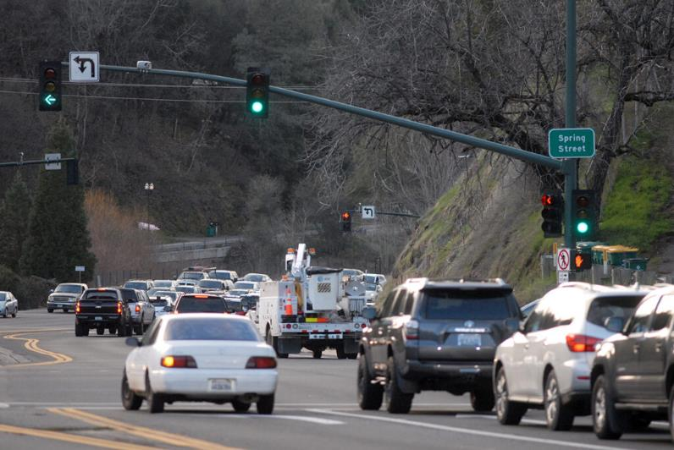
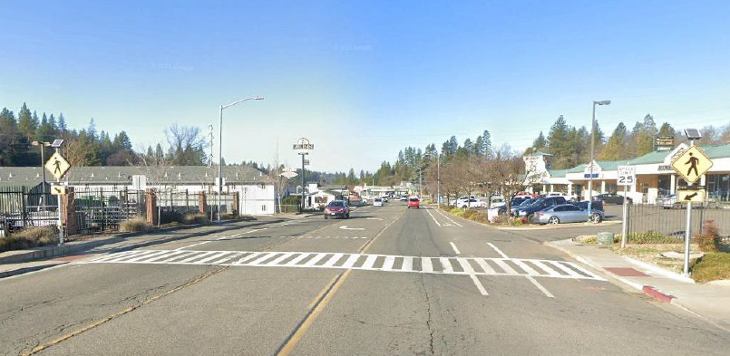
Blueprint in El Dorado

Slide 15
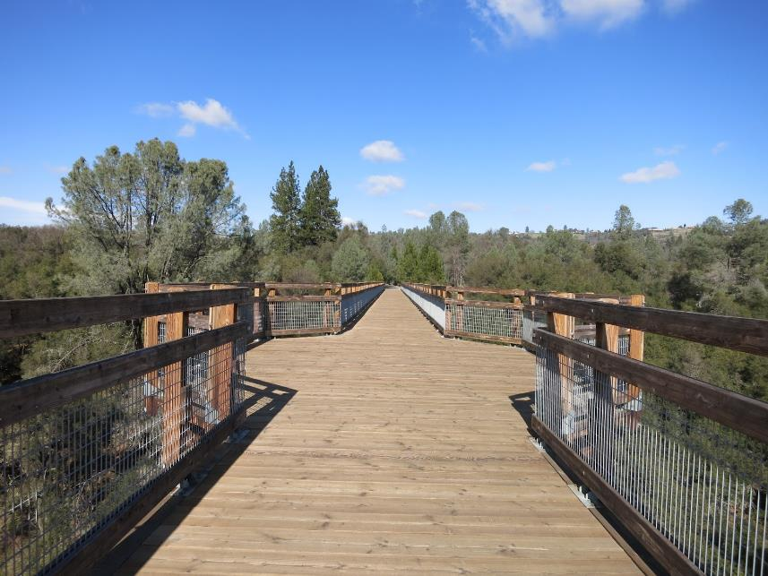
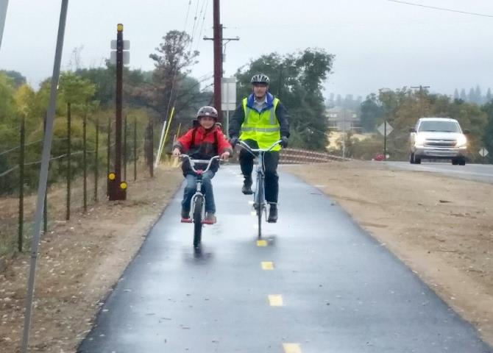
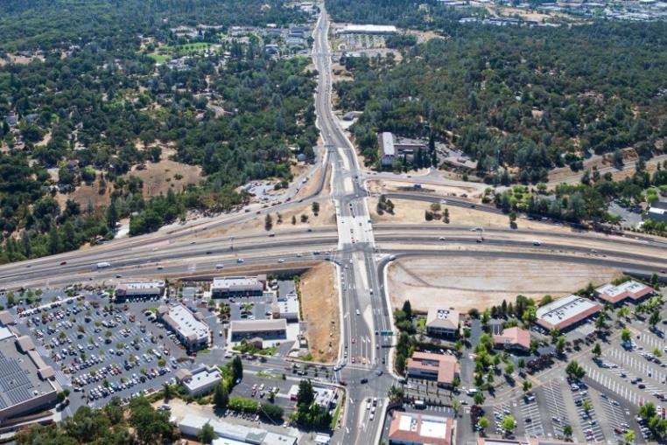
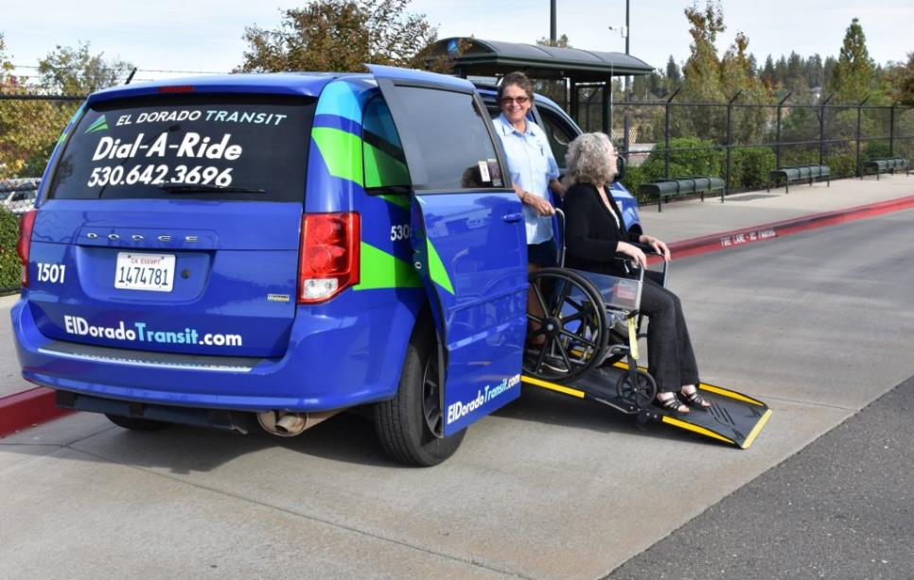
Transportation
Notes:
Why are we creating the 2024 Blueprint?
Aside from this plan being a federal and state requirement, SACOG uses the 2024 Blueprint update to help our constituents coordinate planning efforts to better plan for the Sacramento region’s transportation system. This coordination helps improve the region’s quality of life by making it easier and safer to get where residents need to go.
This is important because the growth and mobility challenges facing the region are complex and are made more so due to the global pandemic, recent record setting drought and fire seasons, and the effects of a staggering statewide housing crisis which are often most acutely felt in historically disenfranchised communities. Finding pathways to create a thriving economy and healthy environment for all residents of the Sacramento region, as they relate to a regional planning effort, requires a holistic approach.

Slide 16
Addressing Transportation Challenges
Plan for and be resilient to wildfires
Prioritize lower cost and quicker projects
Technology solutions to maximize existing capacity
Prioritize maintenance and repair

Slide 17
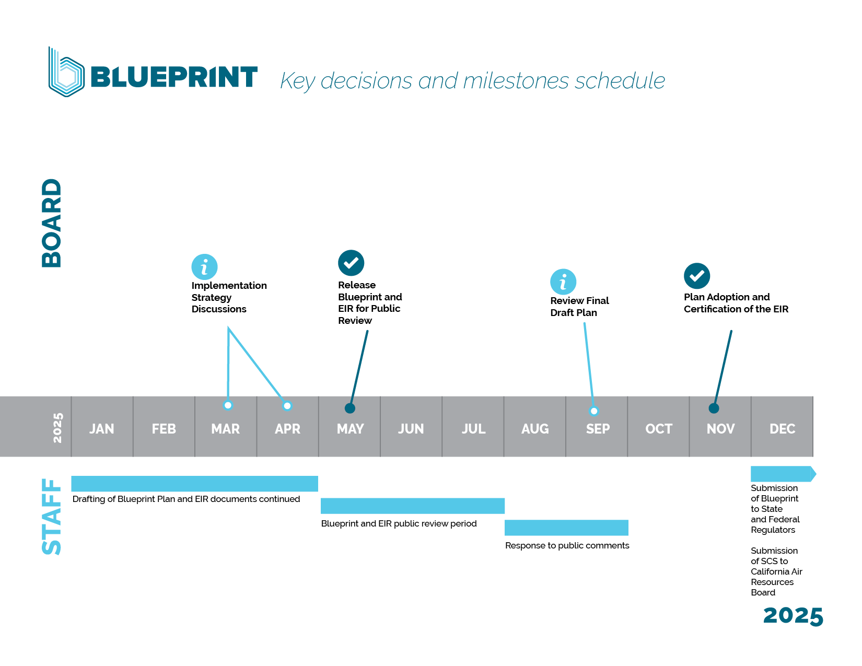

Slide 18
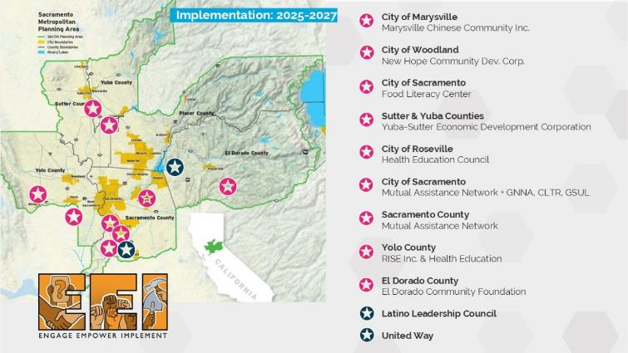
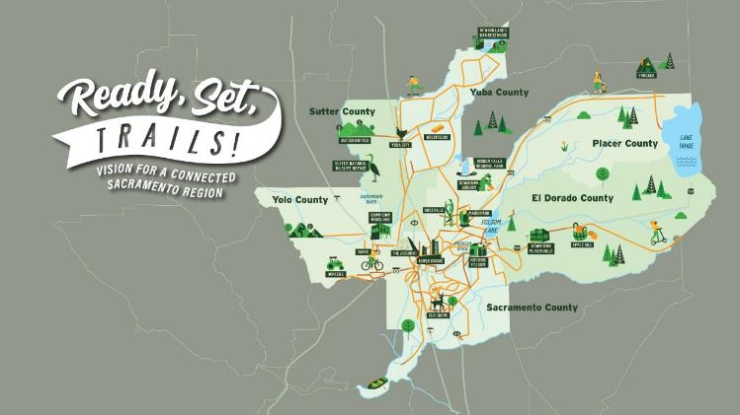
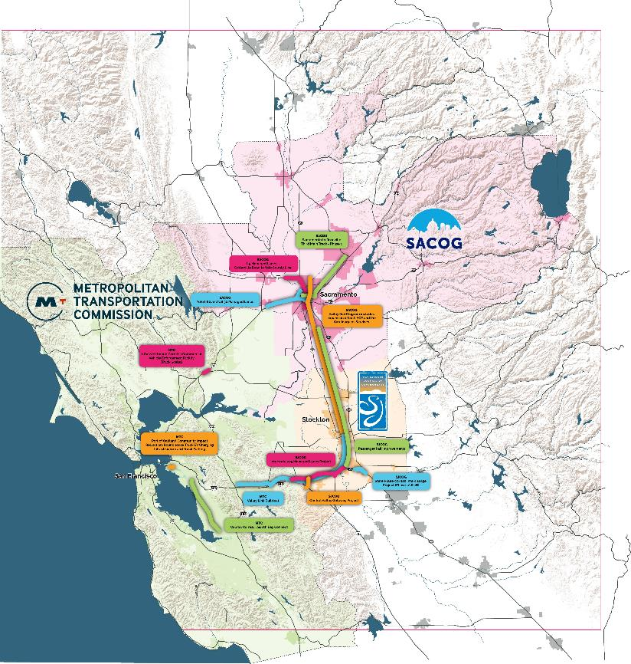
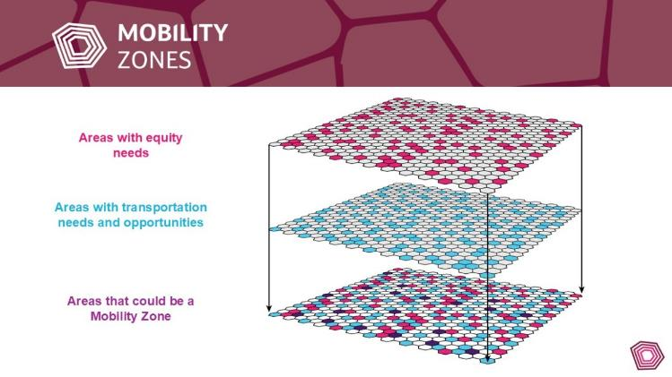

Slide 19
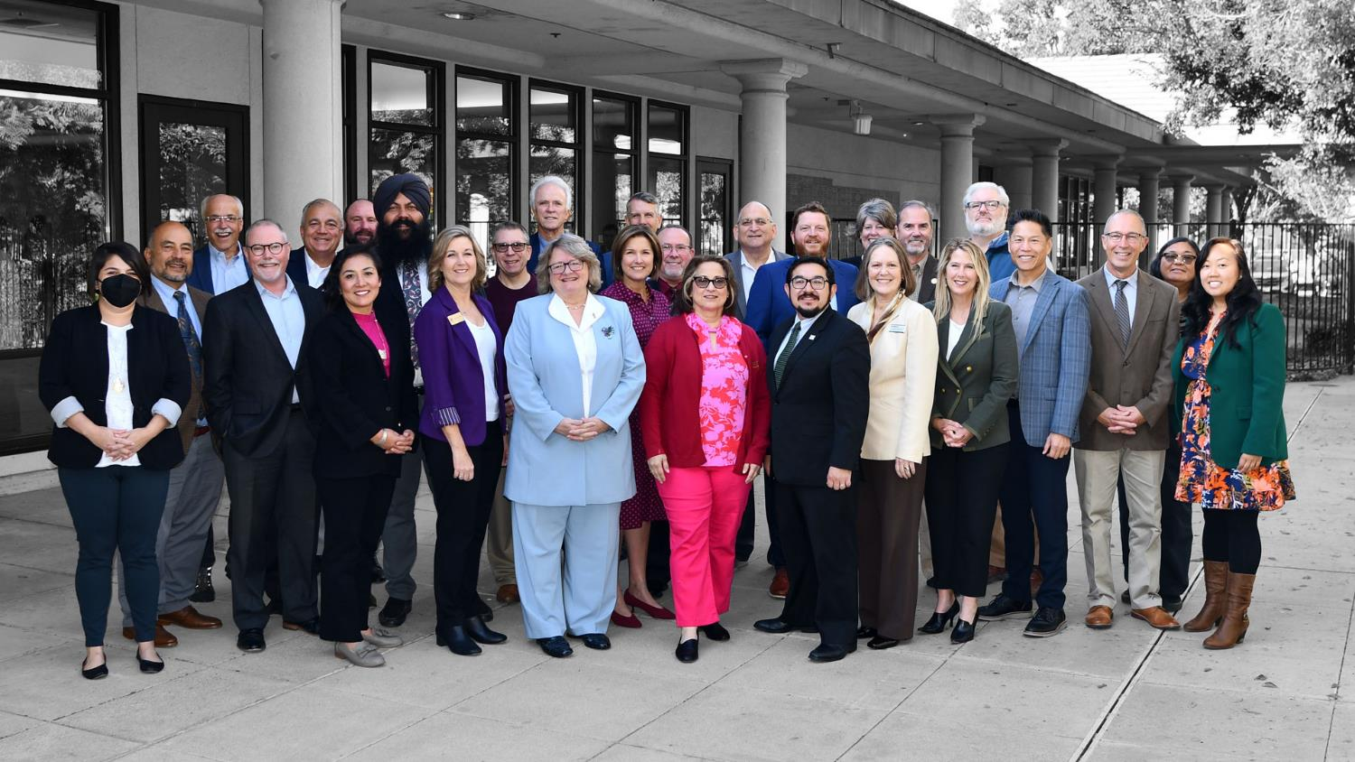
Time for Teamwork

Slide 20
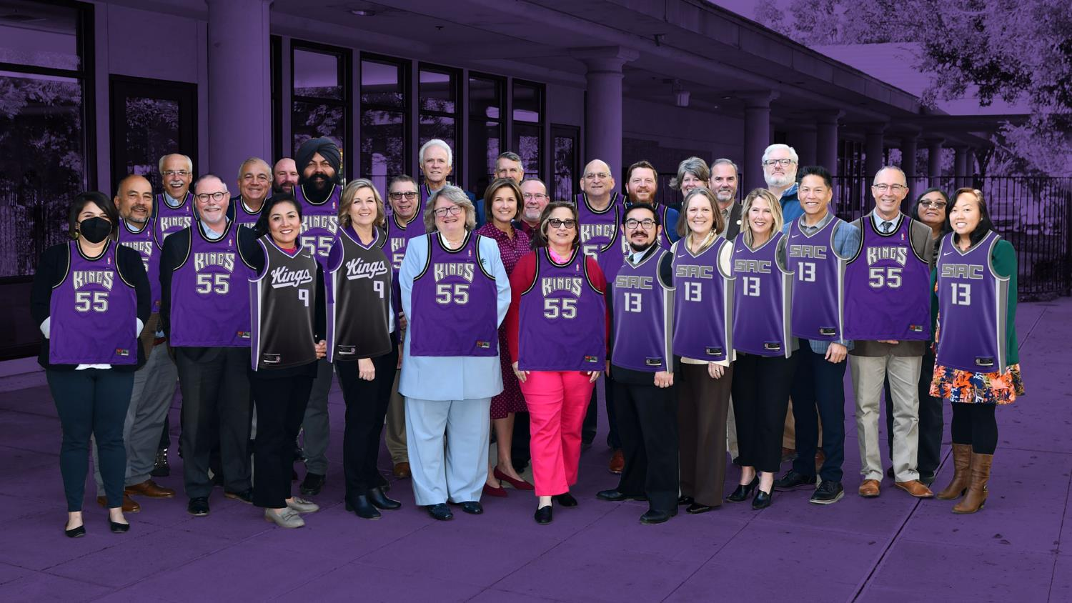
Time for Teamwork

