Slide 1

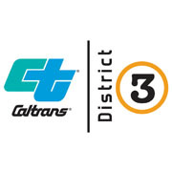

EDCTC Project Update
US 50 Trip to Green
Congestion Management & Resiliency Strategy
August 6, 2026

Slide 2

Agenda
Background
Leverage Plan for PID
Extension Request Approved
Caltrans Coordination
Progress Update
Access Control and Local Improvements
Schedule and Public Outreach
Project Funding Recap

Slide 3
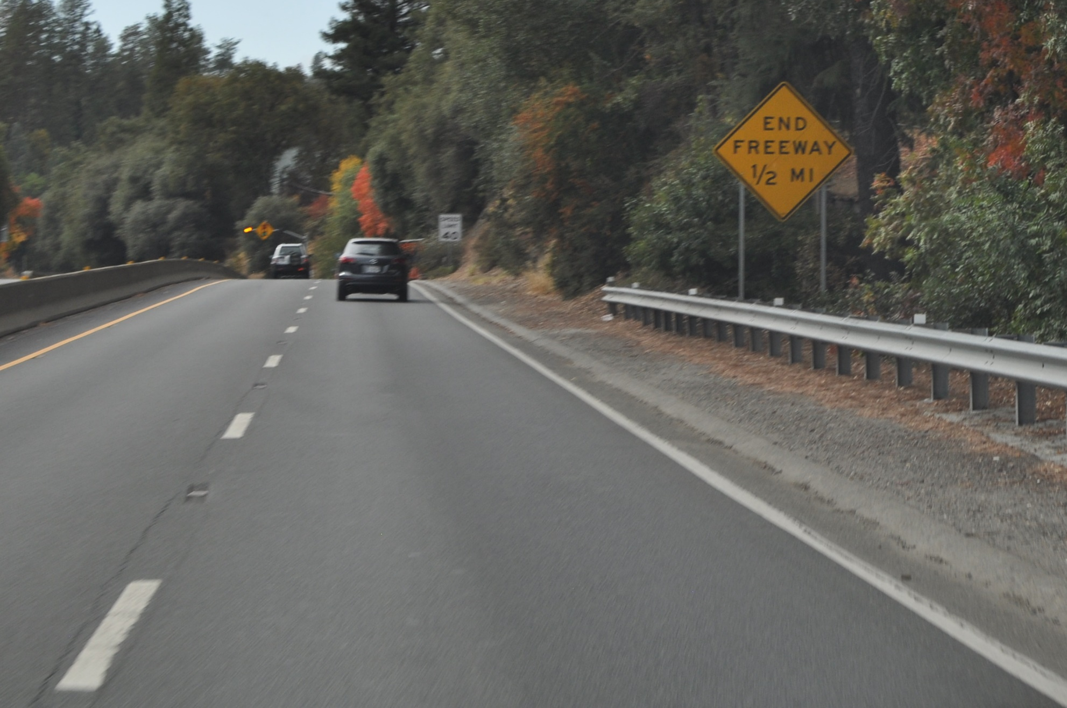
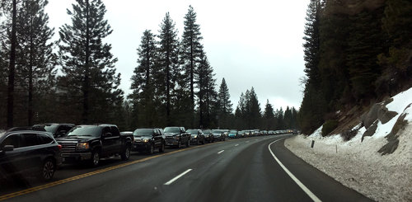
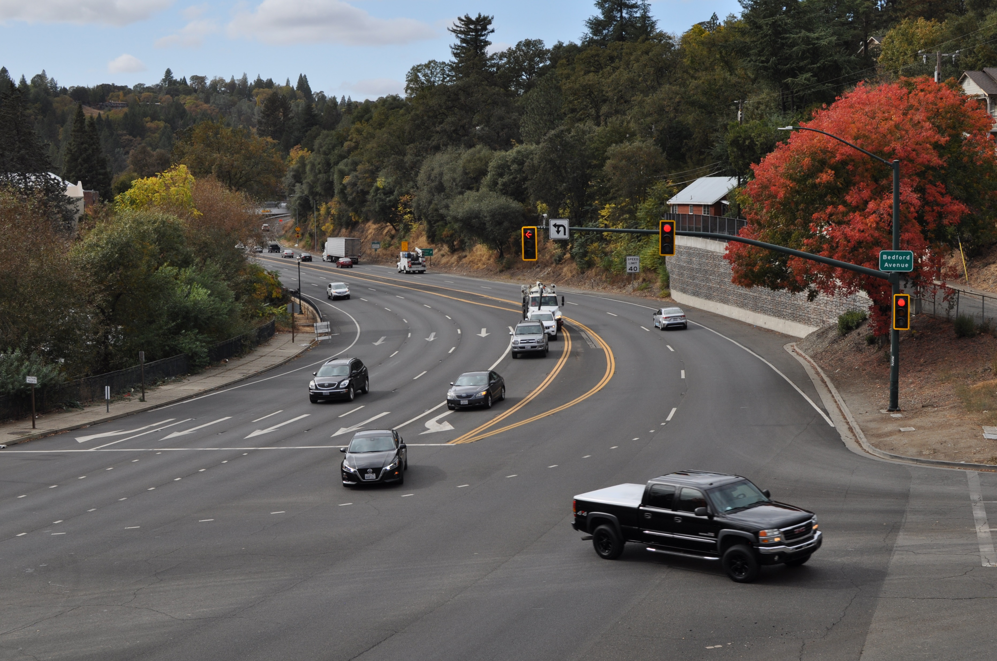
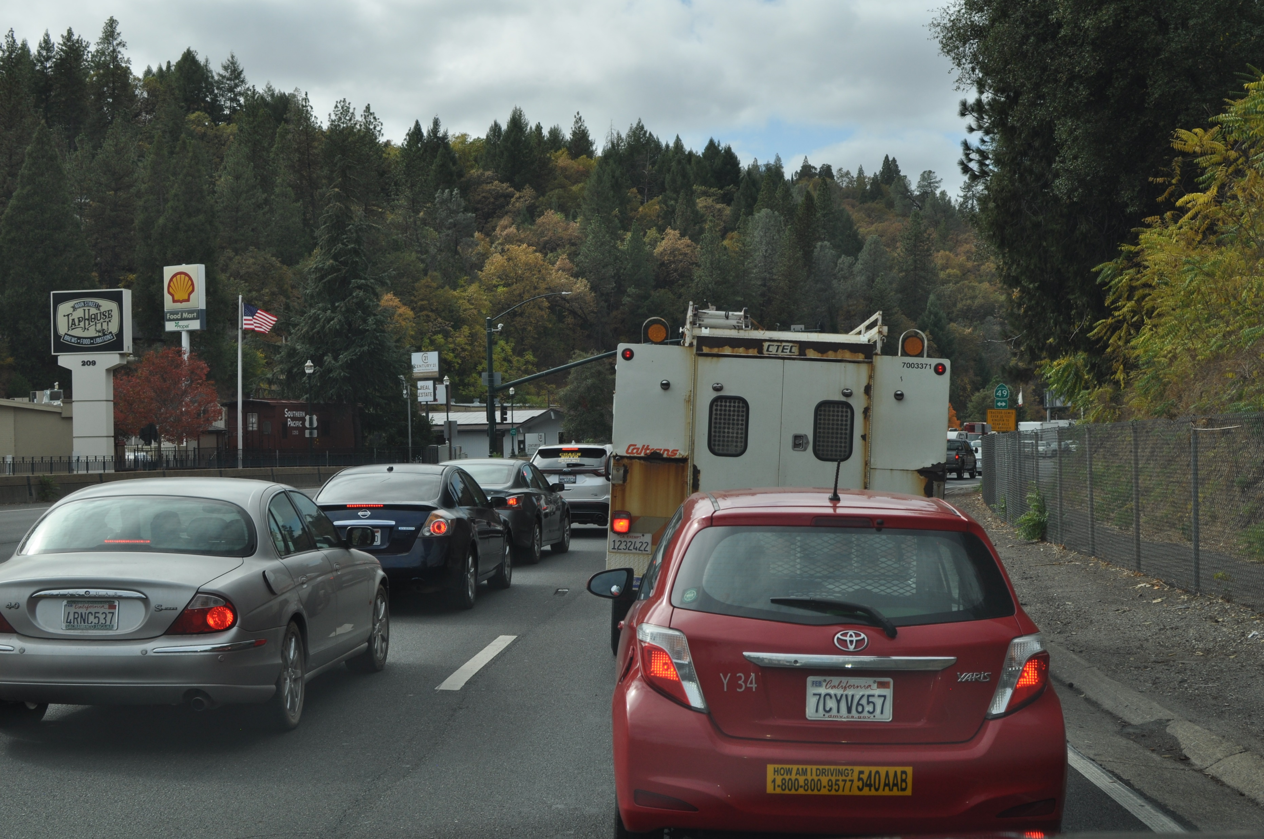
Background: TTG Purpose
Signalized Intersections
Result in Congestion

Slide 4
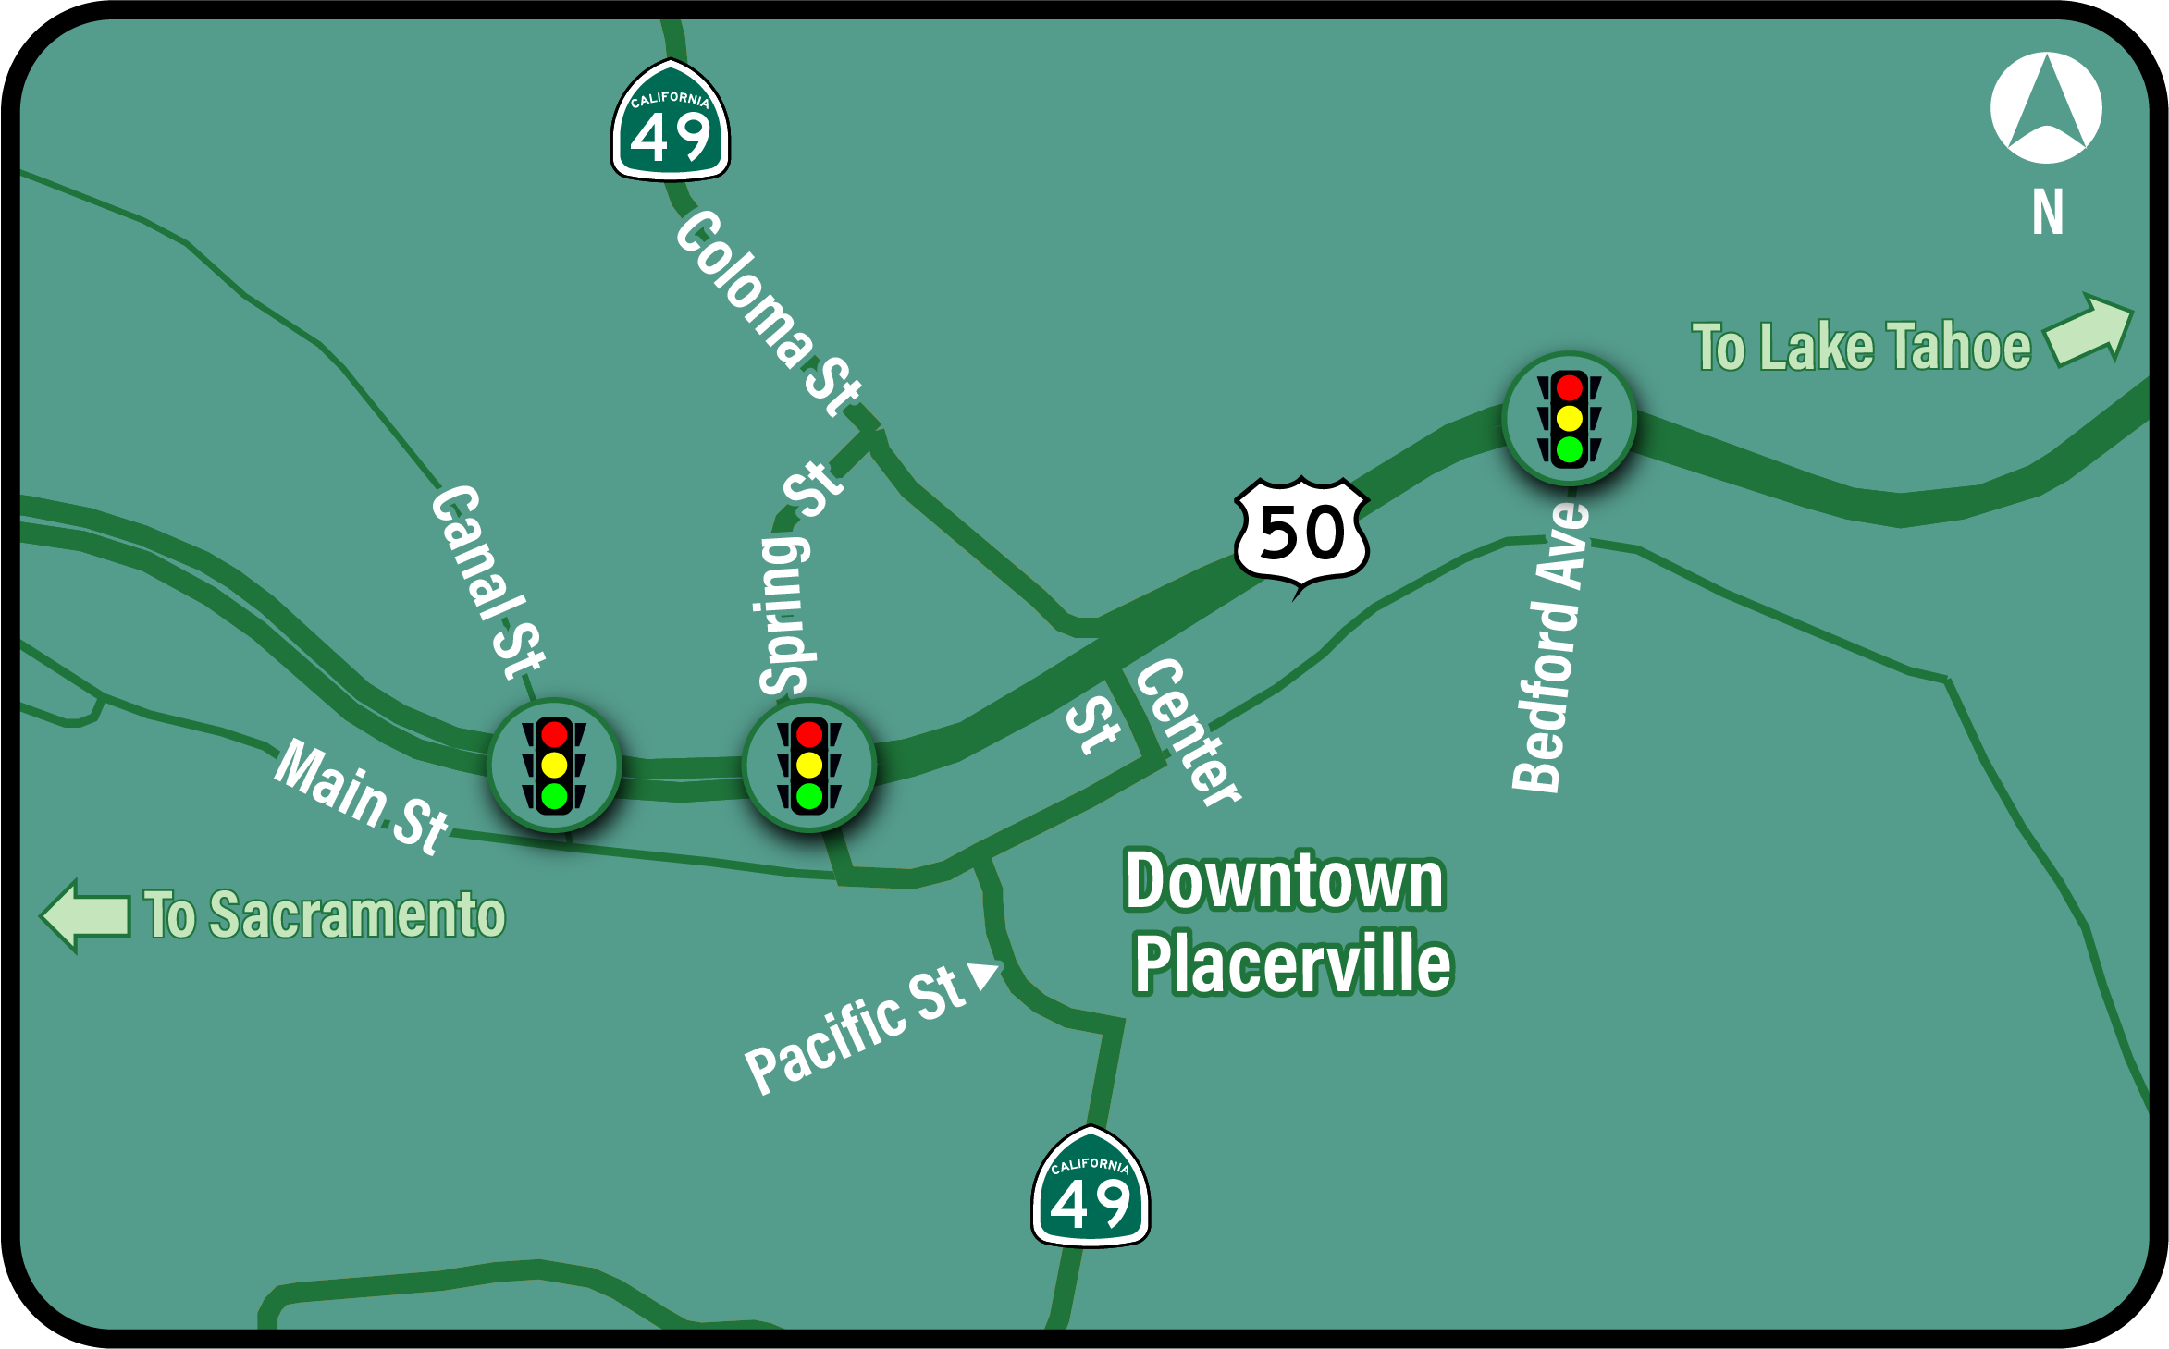
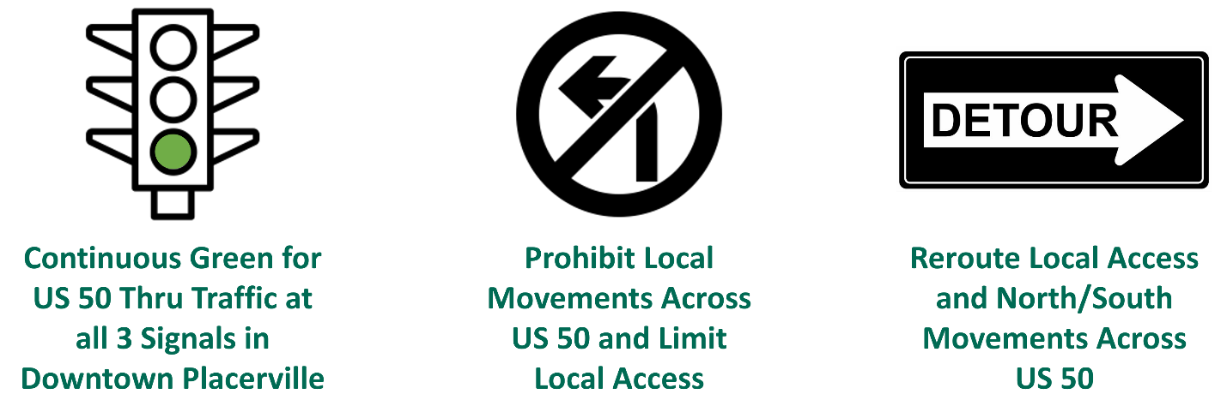
Background: TTG Concept Overview

Slide 5
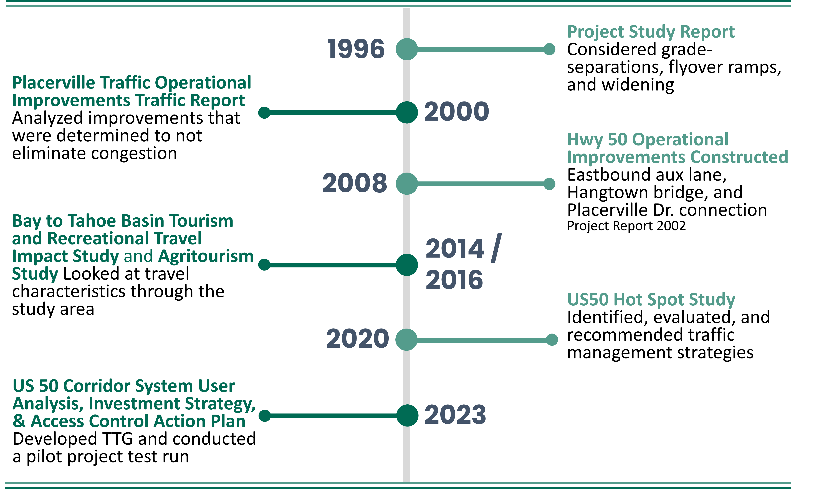
Background: Project History

Slide 6
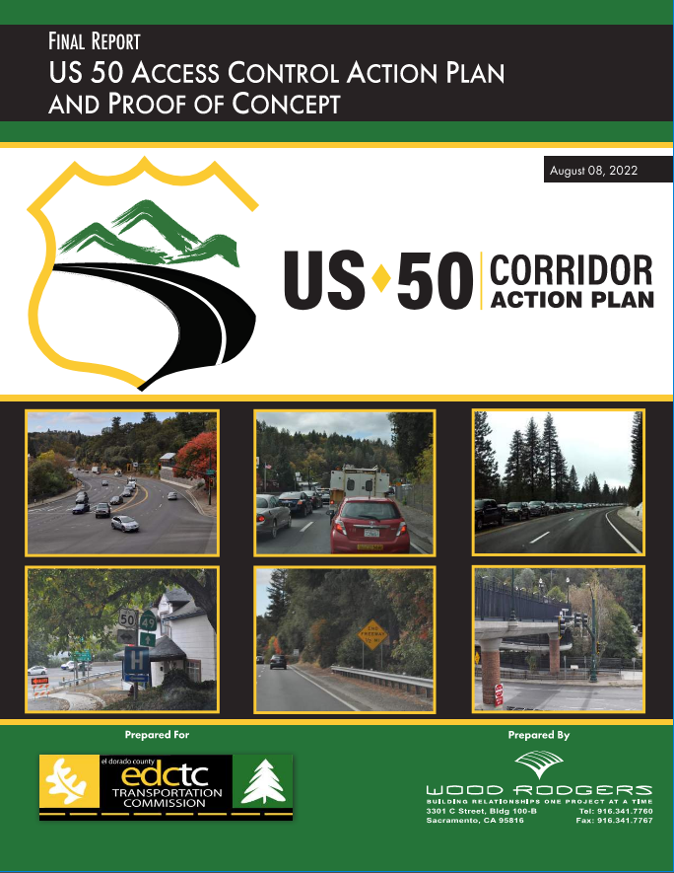
Leveraging the US 50 Action Plan
CTC awarded the City of Placerville $3M in Local Transportation Climate Adaptation Program funding for environmental and design
Extensive Caltrans coordination resulted in the US 50 Action Plan being leveraged as a Project Initiation Document (PID)
Environmental and design for the US 50 Trip to Green Congestion Management and Resiliency Strategy Project commenced February 2025

Slide 7


Agency Coordination
Project Development Team
Collaborate on all major, technical aspects of the study
Communicate/coordinate internally within each organization
Incorporate functional units as needed
Provide insight into public and stakeholder engagement efforts
Meet at key milestones and touchpoints throughout the project

Slide 8
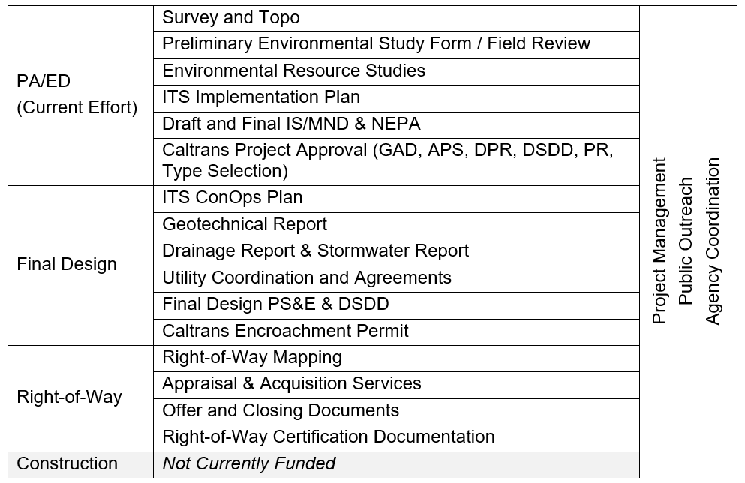
Project Scope Overview

Slide 9
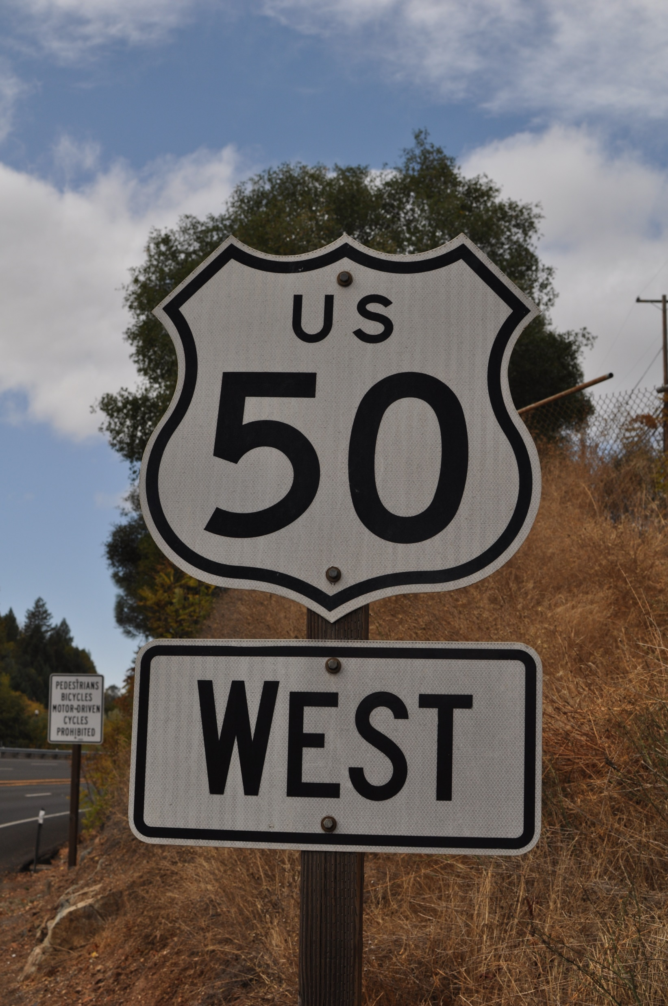
Design Elements
  Major Design Elements
  Detour Signage Throughout
  Porkchop Islands with Wedge Barriers
  Signal Modifications at Canal Street, Spring Street, and Bedford Avenue
  New or Extended Barriers and Crash Cushions
  Drainage Modifications
  Pedestrian Bridge Overcrossing

Slide 10
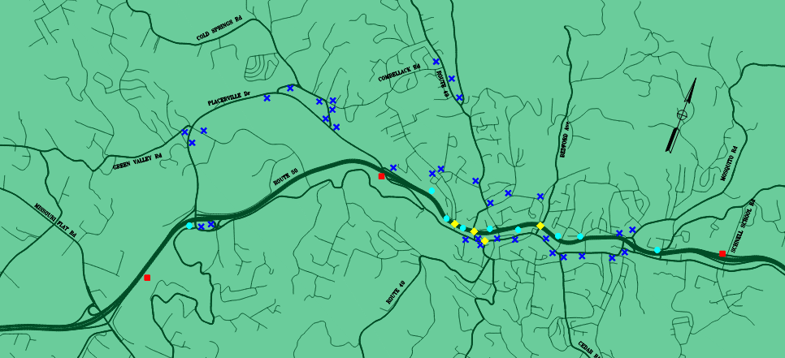
Design Elements
3 Overhead Changeable Message Signs (red)
9 Overhead Extinguishable Message Signs (cyan)
35 Two-Post Extinguishable Message Signs (blue)
4 Intersection Modifications (Yellow)

Slide 11
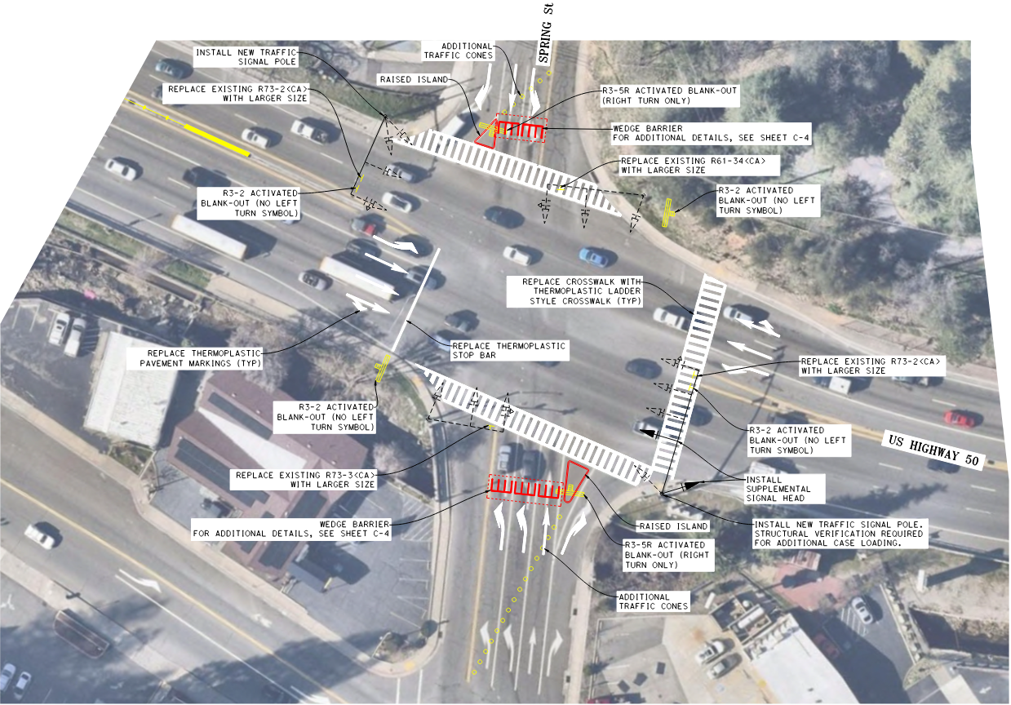
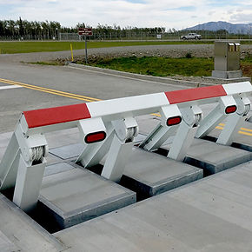
Design Elements
  Spring St. Example
  Blank-out signs for restricted turn movements
  Pork-chop island channelization
  Wedge barrier barricades

Slide 12
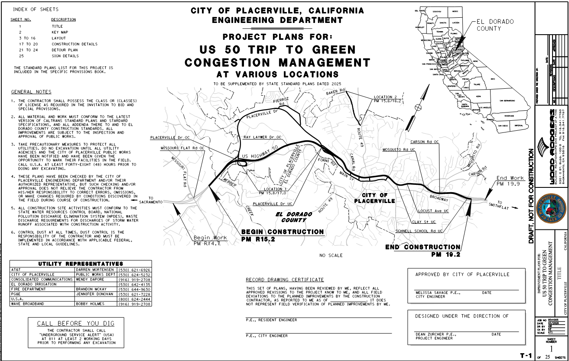
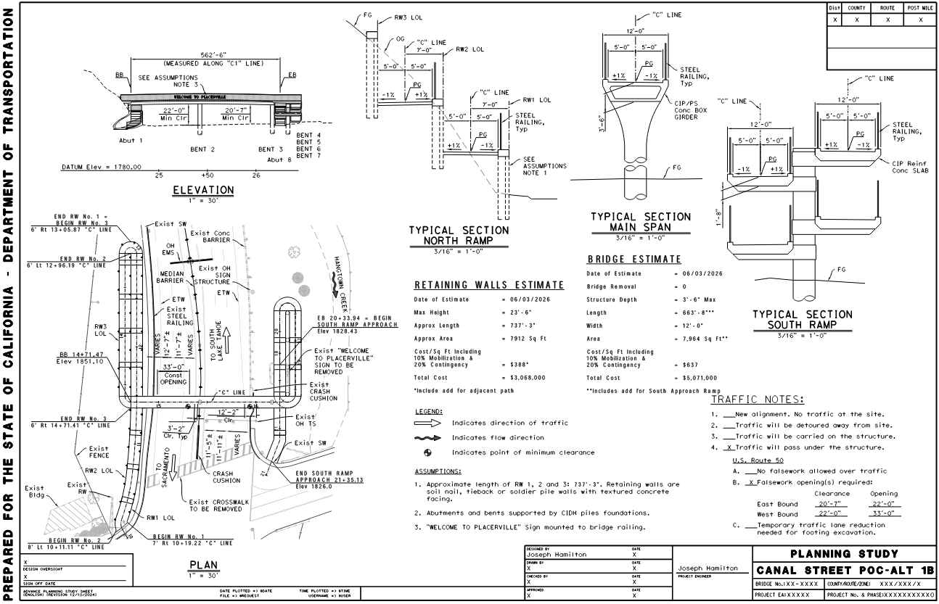
Progress to Date
Roadway and Structural Design
  Completed Topo Survey and Utility Base Mapping
  Completed Extensive Left-Turn Treatment Evaluation
  Submitted Draft Geometric Approval Drawings (GAD)
  Submitted Bridge Advanced Planning Study (APS)¹
¹ APS for bridge type approval. Aesthetic details TBD during final design.

Slide 13
Progress to Date
Environmental Scoping Coordination Completed in March 2025
Determined that a formal PEAR was not necessary
CEQA
City of Placerville is the Lead Agency Delegated by District 3
Anticipated CEQA Document – Initial Study with Mitigated Negative Declaration
NEPA
NEPA Nexus is Federal Grant Funding
Caltrans is the NEPA Lead Agency Delegated by FHWA
Anticipated NEPA Document – Categorical Exclusion with Supporting Environmental Technical Studies

Slide 14
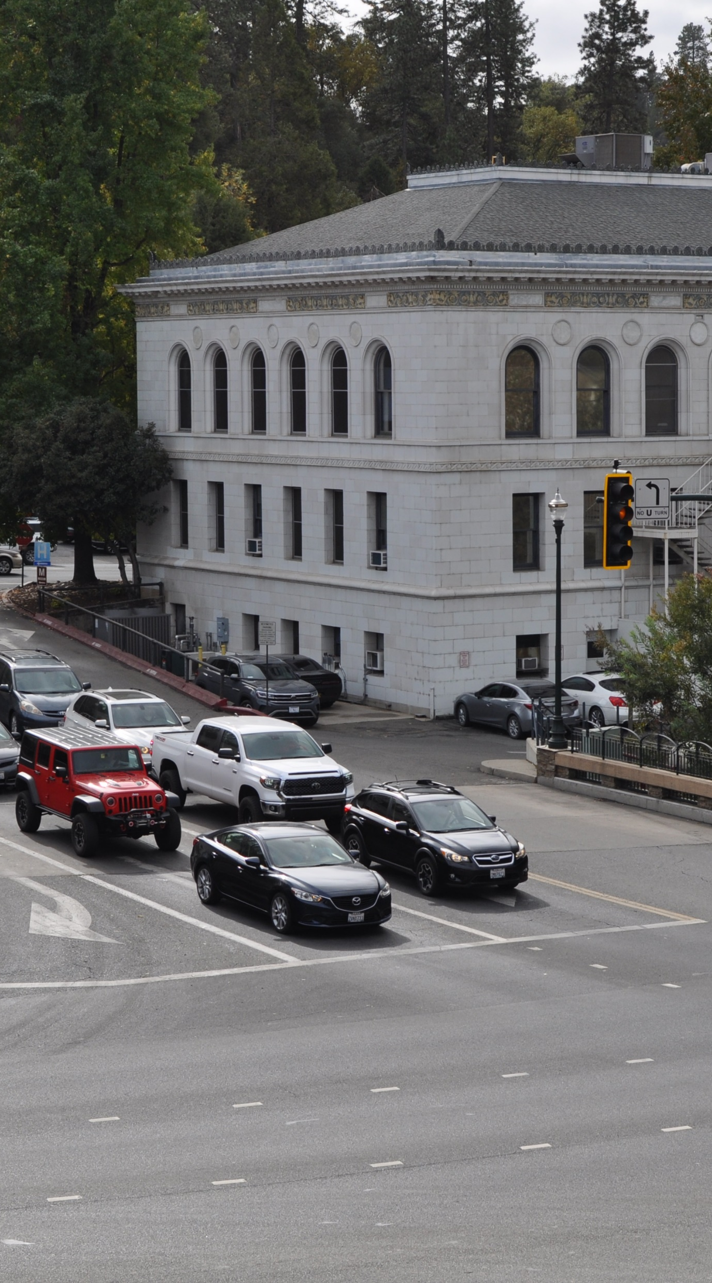
Progress to Date
Environmental Technical Studies Summary
Natural Environment Study
Community Impact Assessment
Water Quality Assessment Report
Visual Impact Assessment
Construction Noise Memorandum
Hazardous Waste Initial Site Assessment
Historic Property Survey Report/Archaeological Survey Report/Historic Resources Evaluation Report + Finding of No Adverse Effects

Slide 15
Project Schedule and Outreach
Feb
2025
Feb
2026
Feb
2027
Mid
2028
June
2026
Funding Extension Request Approved
June
2027
Funding Allocation Deadline
Preliminary Env. Docs
Env. Tech Studies
CEQA/NEPA Docs
Engineering Studies
Project Report
Final Design/ROW
Public & Stakeholder Engagement
Public
Meeting
Public
Meetings

Slide 16
Project Funding
Funding Summary
$3M funding final design and right-of-way (LTCAP)
Unfunded for construction
SACOG regional priority project

Slide 17
Next Steps
Finalize draft environmental tech studies
GAD and APS approvals
Prepare draft CEQA document and Project Report
Advance ITS concept and evaluation
Continuous Caltrans coordination

