Slide 1
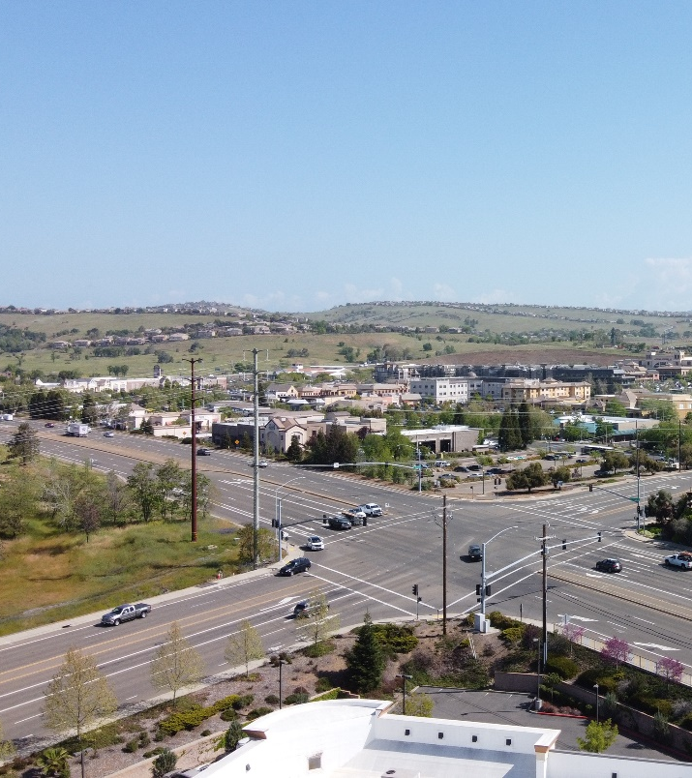



Next Generation Transportation Investment Strategy
April 2, 2026

Slide 2
The El Dorado County Transportation Commission (EDCTC) was awarded $217,124 in Sustainable Communities Competitive Grant funding to prepare the Next Generation Transportation Investments Strategy (Next Gen Strategy or Strategy) to provide data, analytics, and information to support transportation investments across the western slope of El Dorado County.

Slide 3
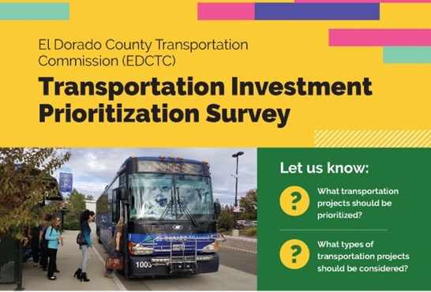
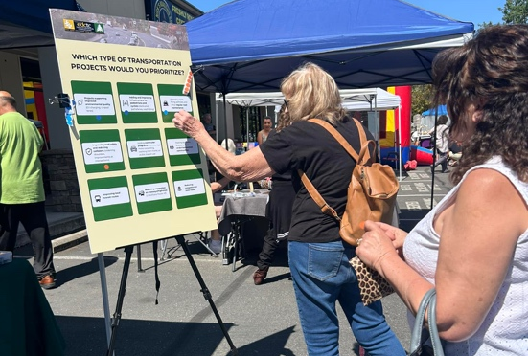
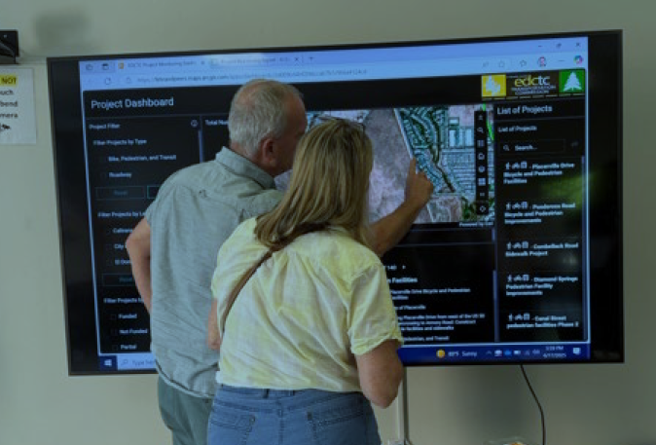
Community Engagement
Online Engagement
Pop-ups
Workshops
Transportation Investment Survey with over 450 responses
(May - June 2024)
Social Pinpoint Online Map Engagement
(Oct 2024 – Jan 2025)
Cameron Park Springfest
Placerville Wednesday Night Farmers Market
(May 2024)
Community Workshop
(June 17th, 2025)
Virtual Workshop
(June 24th, 2025)

Slide 4
Survey Results Summary
Overall Importance Score

Slide 5
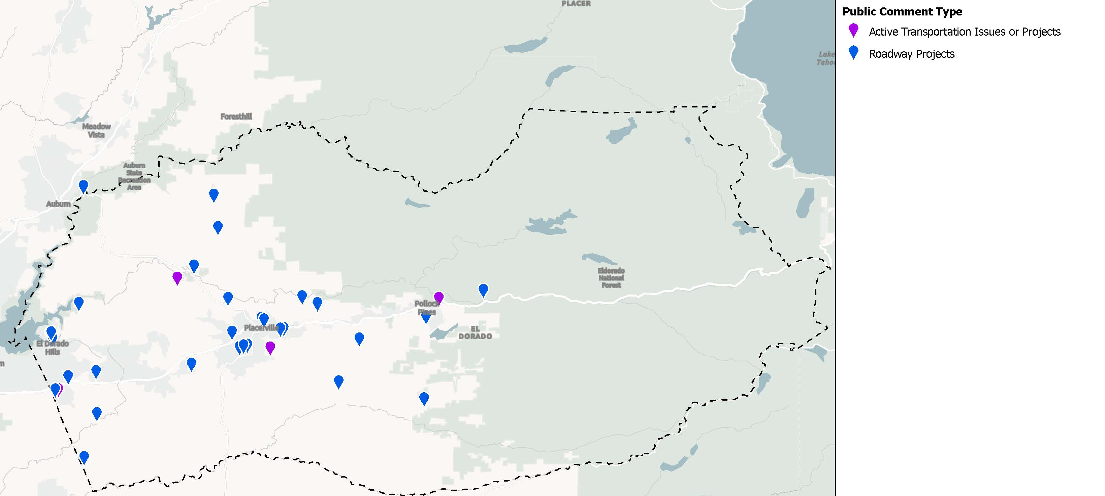
Social Pinpoint Input

Slide 6
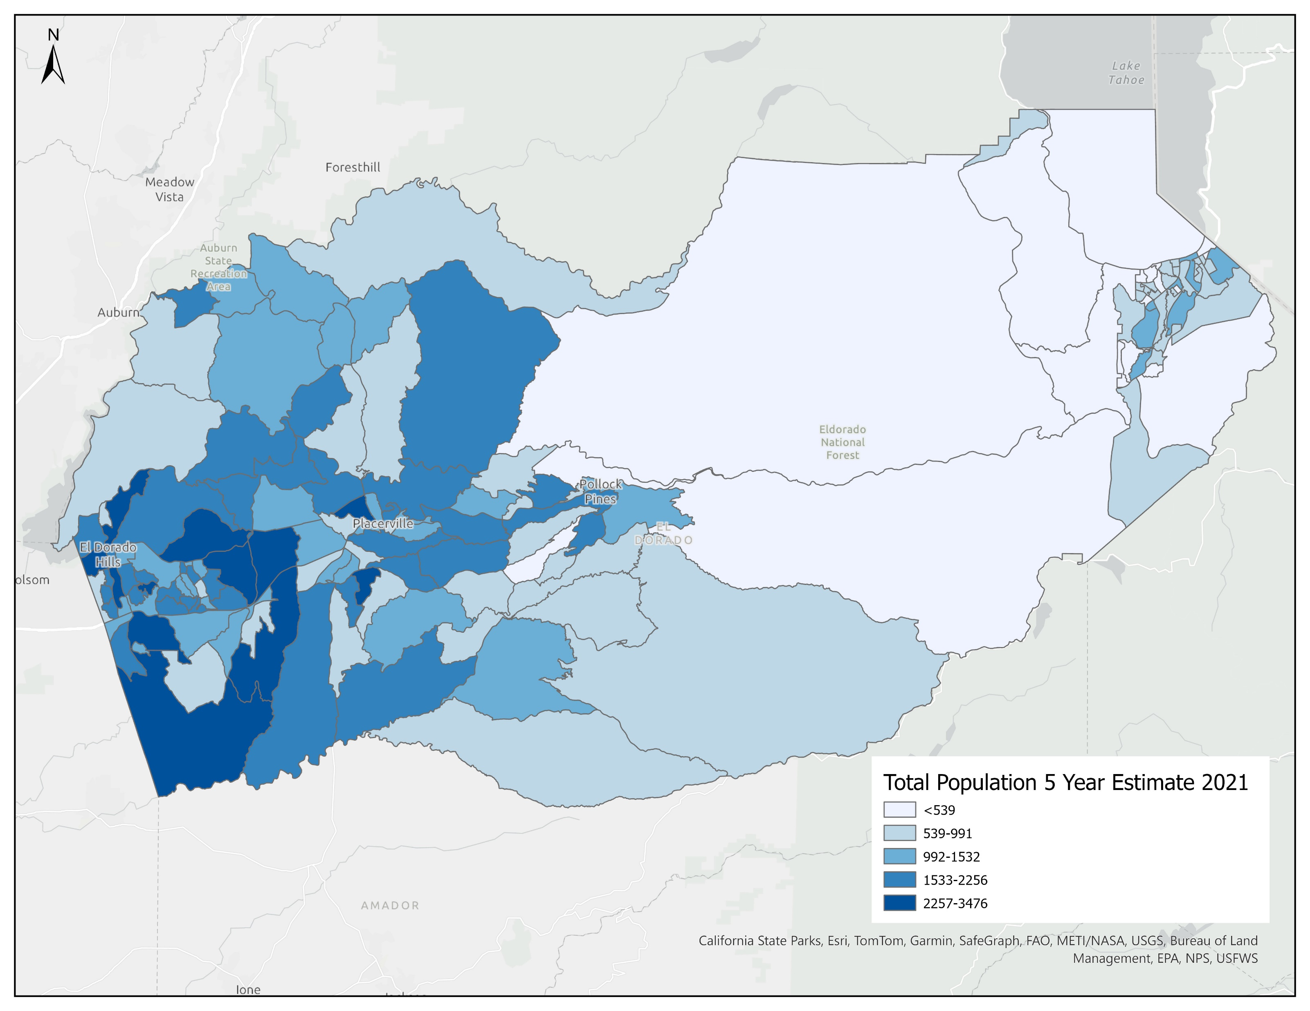
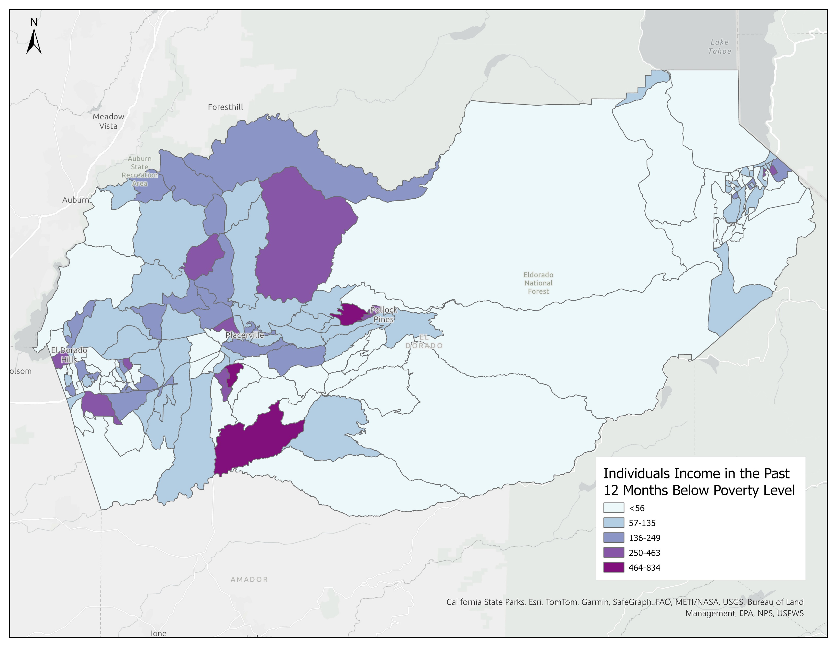
Demographic Patterns
Population and Income
Population mainly distributed in western county
Areas with higher percent of people with income below the poverty level (Nashville, Somerset, Diamond Springs, Pollock Pines…)
Source: ACS 5-Year Estimates, 2021
Individuals Income in the Past 12 Months Below Poverty Level (2021)
Total Population 5-year Estimate 2021 in El Dorado County

Slide 7
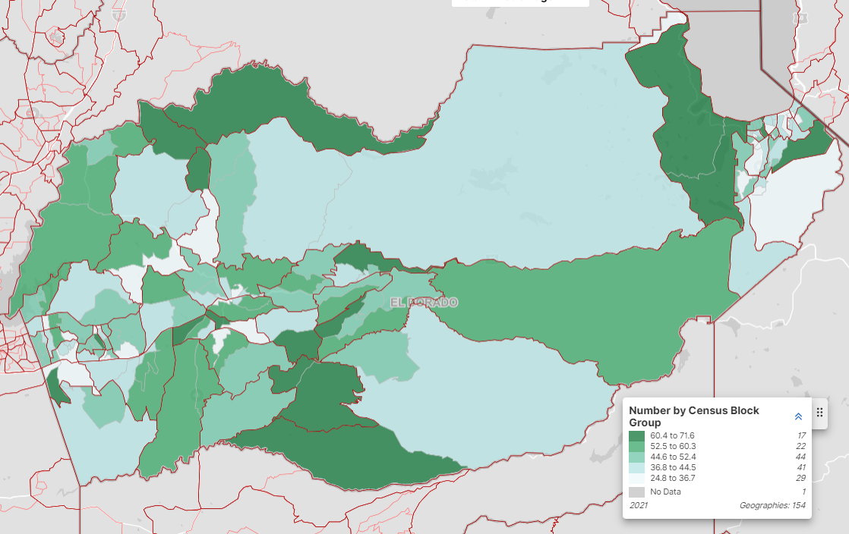
Aging Population Trends
Higher percent of population of 65 years and over than statewide average
Increasing percentage of senior population
Demands more alternative transportation (rideshare, transit, active transportation)
Lower workforce participation reduces Travel Demand Management effectiveness on commutes trips
Source: ACS 5-Year Estimates, 2021 Median Age ACS 5-Year Estimates
Median Age by Census Block Group in El Dorado County
Notes:
We are seeing a similar trend in ED County to California

Slide 8
Social and Recreational Travel
High percentage of social and recreational trips
More social and recreational trips in Fall (Apple Hill, river trips, hiking, skiing, etc.,)
Source: Replica; Zartico
Notes:
We will look for more available data regarding Apple Hill volumes over years

Slide 9
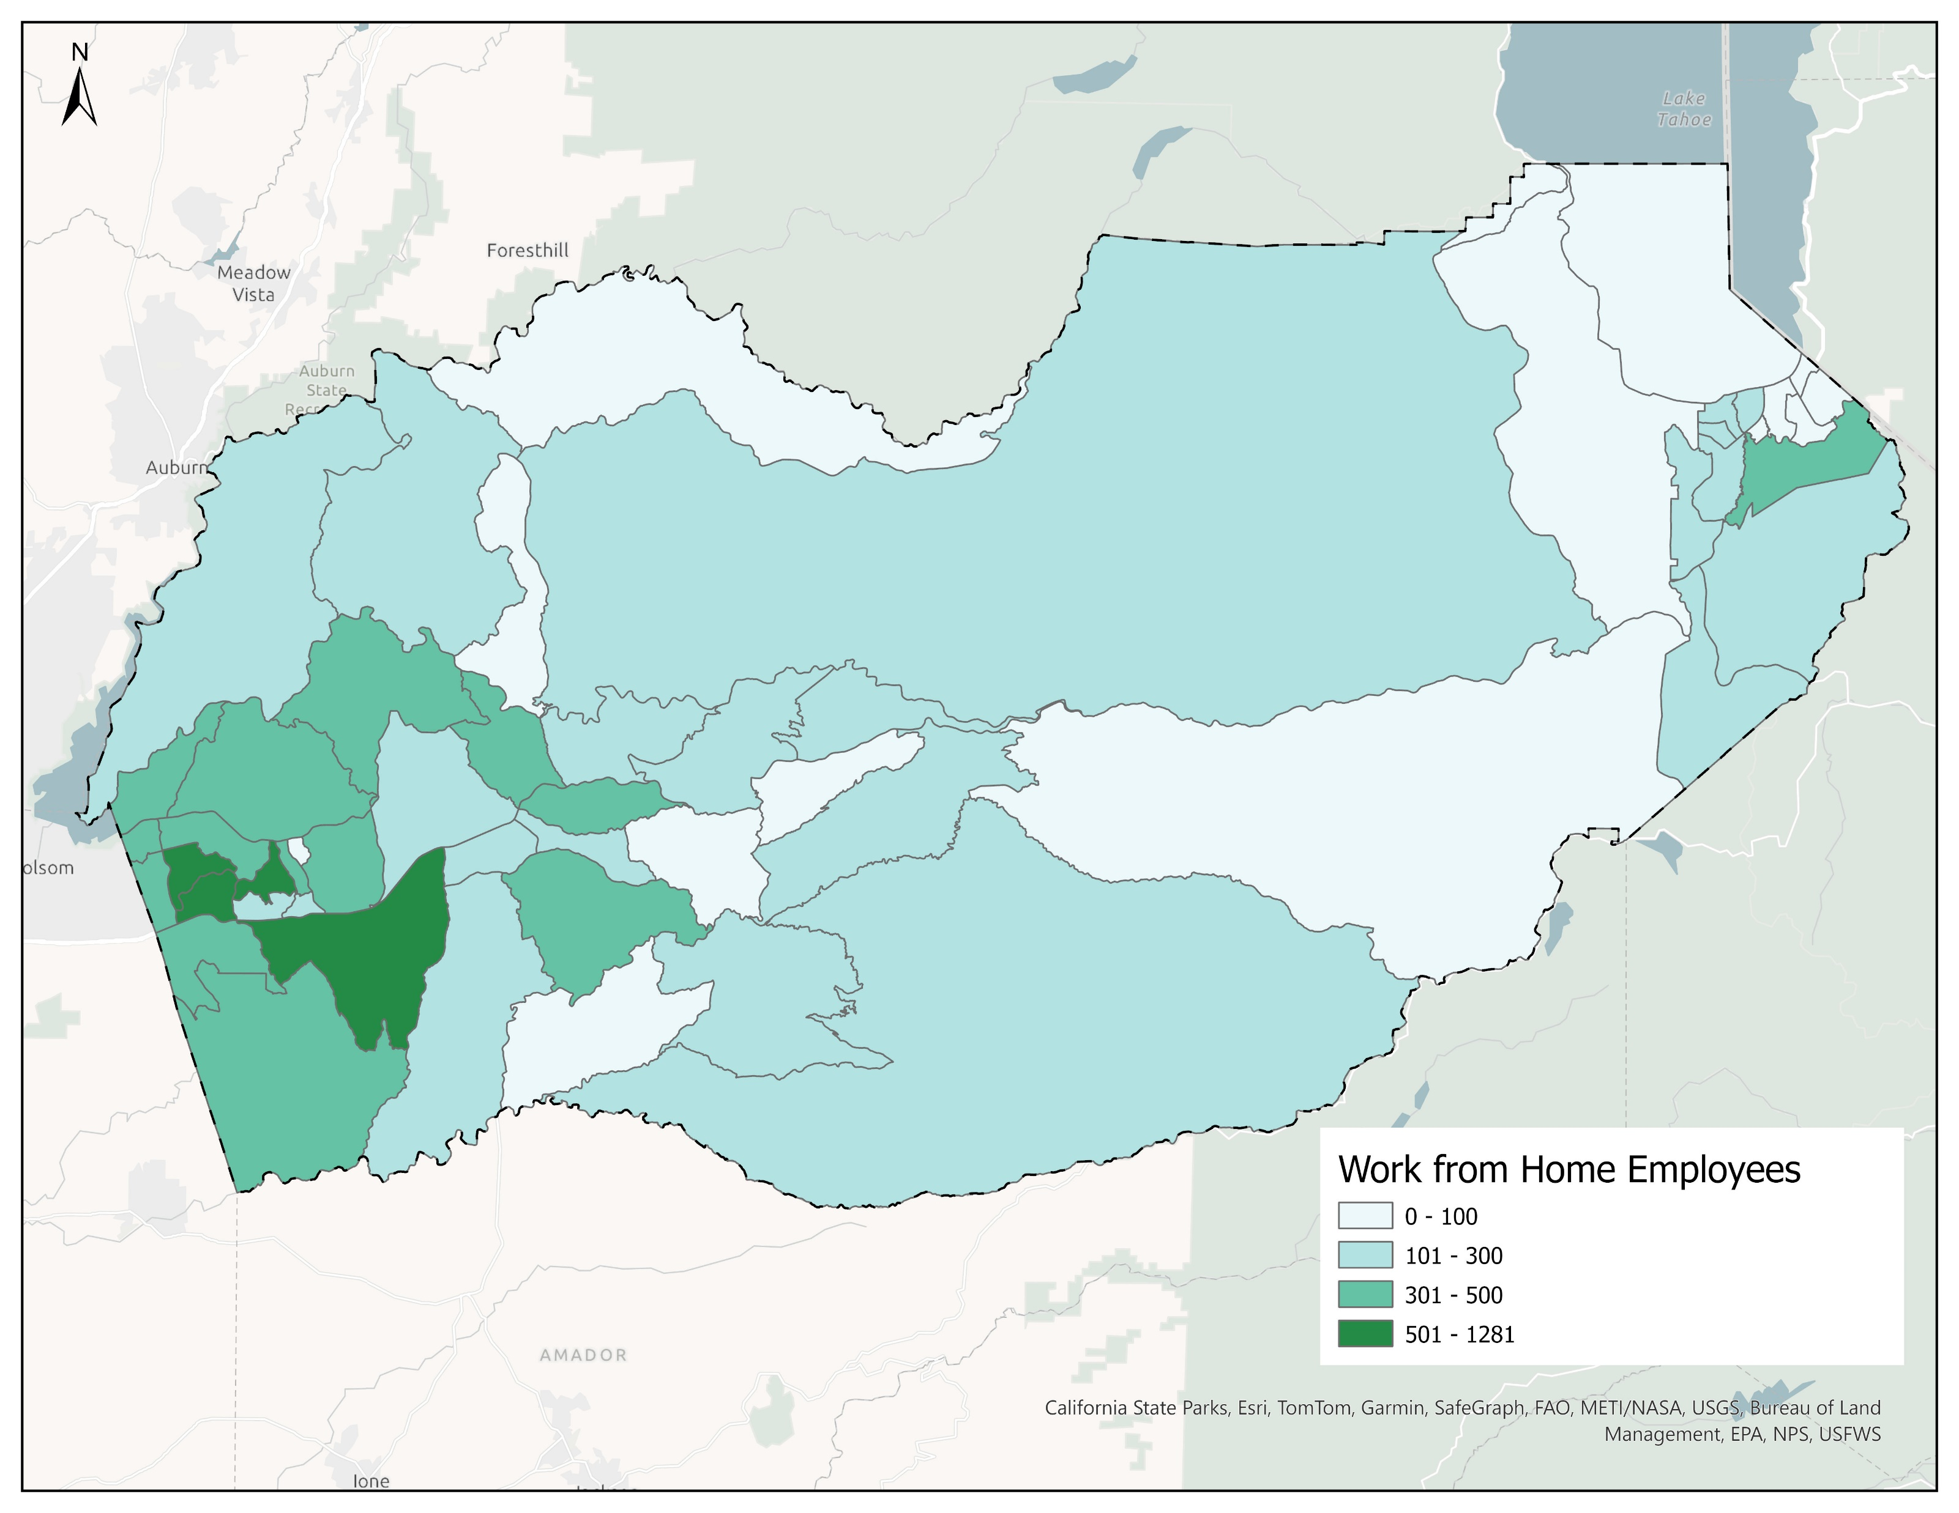
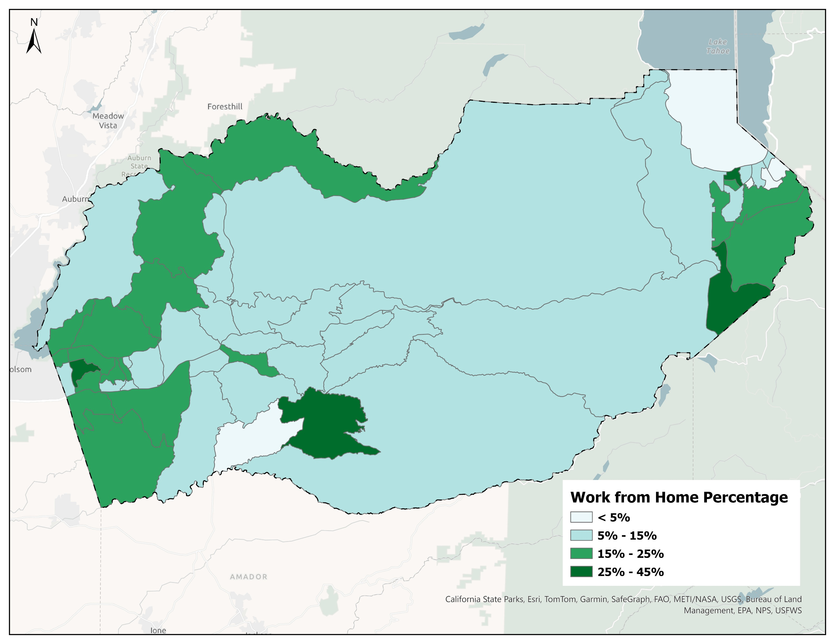
Working from Home
Higher percent of workers WFH than statewide average
Increasing WFH workers
Larger amount of workers WFH:
Cameron Park, El Dorado Hills, Shingle Springs
Higher percent of WFH:
El Dorado Hills, Somerset
Workers Working from Home
Percentage of Workers Working from Home
Source: ACS 5-Year Estimates; 2021 Means of Transportation Map by USDOT BTS
Notes:
We are seeing same trend in ED County as California

Slide 10
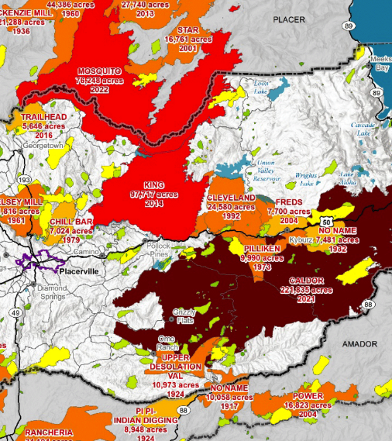
Resilience Risks
for El Dorado County
Climate Related Hazards to Transportation
Extreme Heat
Wildfire
Extreme Weather, Flooding, and Dam Failure
Landslide and Erosion

Slide 11
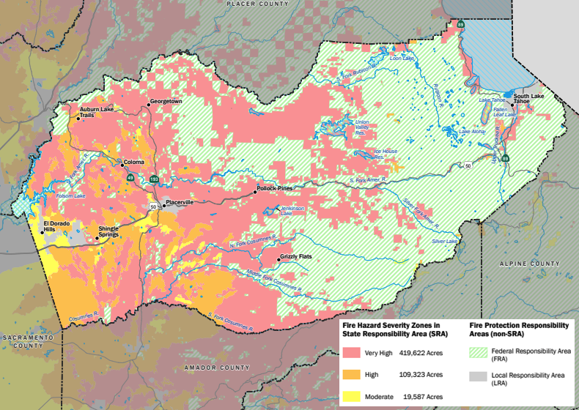
Wildfire Responsibility Areas and State Fire Hazard Severity Zones

Slide 12





Future Trends Transportation Performance Measures
Vehicle Miles Traveled (VMT): Assesses changes in regional travel demand and congestion levels.
Transit Ridership: Forecasts shifts in public transit usage under different conditions.
Greenhouse Gas (GHG) Emissions: Estimates emissions reductions based on VMT and electric vehicle penetration.
Transportation Revenue Implications: Evaluates how changes in fuel consumption and transit ridership affect funding sources.
Equity Considerations: Analyzes disparities in travel impacts among low-income populations versus the general population.

Slide 13
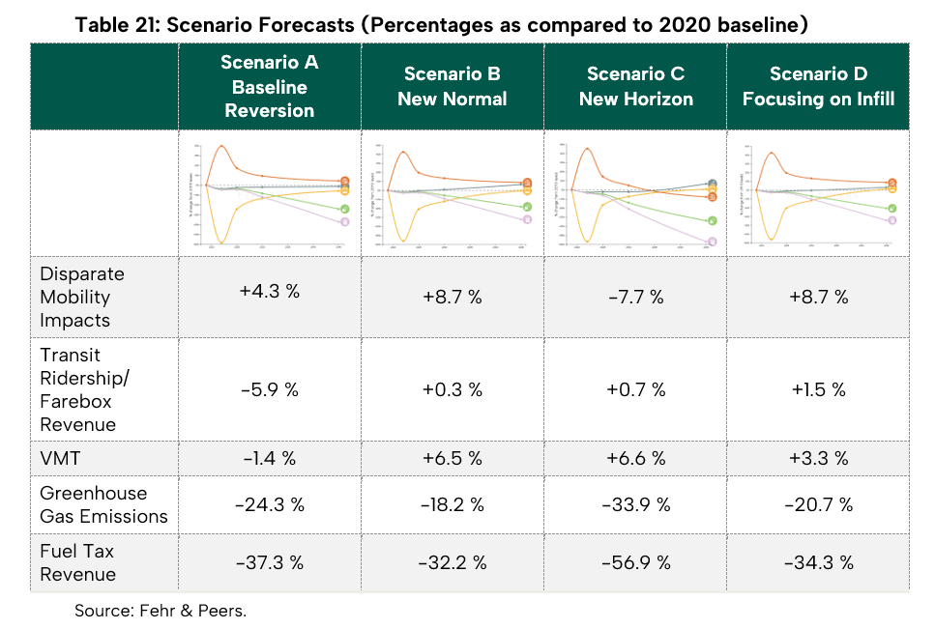
Future Transportation Trends

Slide 14
Funding Outlook
Development Fees will continue to fund transportation improvements in areas affected by the development within the County
VMT Mitigation Banks are being explored at state, regional, and local levels which could help support sustainable development and infrastructure.
Roadway Pricing is being implemented on Caltrans freeways across the state and may be a useful tool on US 50 to offset regional traffic impacts.
Local Sales Tax measures provide reliable, locally controlled, transportation funding but must be approved by a two-thirds vote.

Slide 15
Project Performance Evaluation
The Next Gen Study refers to EDCTC 2025–2045 Regional Transportation Plan (RTP) and incorporates goal-based performance measures that link projects to statewide objectives such as sustainability, resilience, safety, equity, and reduced vehicle miles traveled, ensuring that the county’s investments align with evolving state and regional funding expectations.

Slide 16
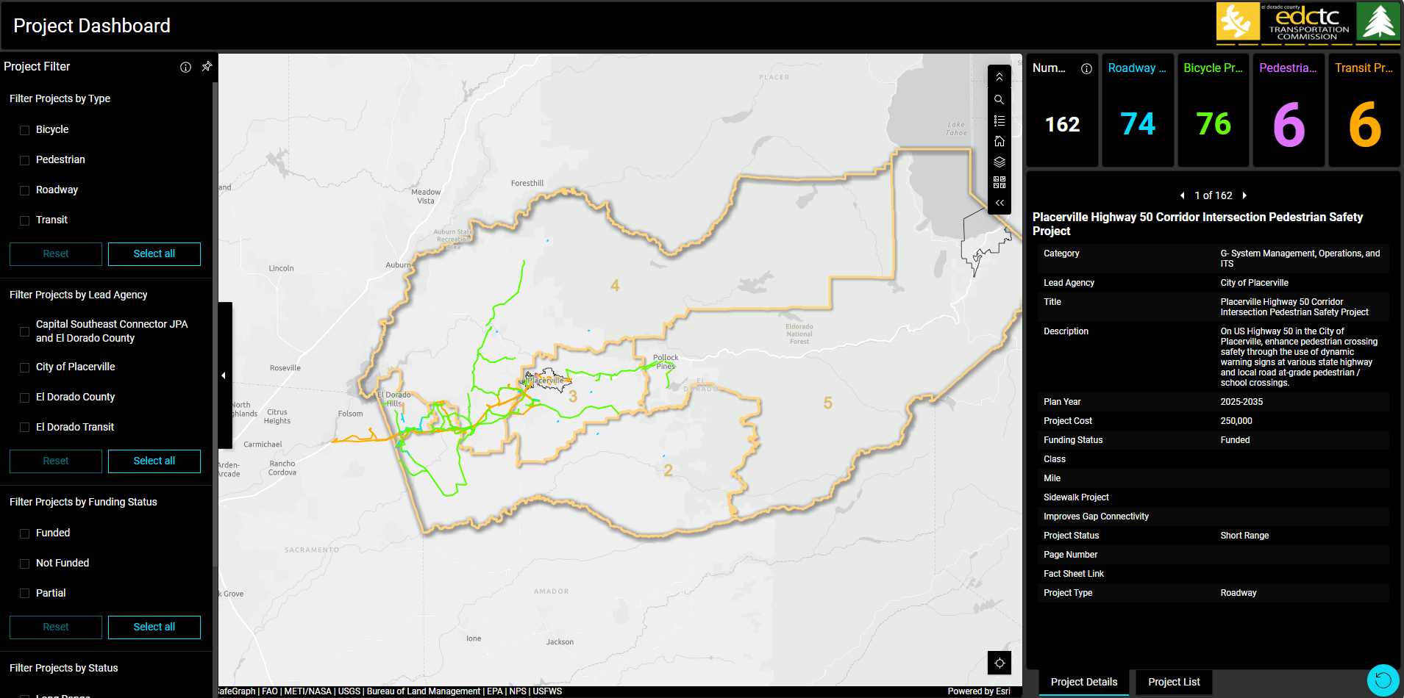
Project Dashboard

Slide 17
Thank You

