Slide 1

DRAFT ACTION ELEMENT
August 7, 2025

Slide 2
REGIONAL TRANSPORTATION PLAN 2025-2045 DRAFT ACTION ELEMENT
The Action Element identifies short- and long-term actions needed to achieve the RTP’s objectives and implement the RTP in accordance with the goals, objectives, and strategies set forth in the Policy Element
Short Range = 2025-2035
Long Range = 2035-2045
Unconstrained Project List = Beyond 2045

Slide 3
HOW DID WE GET HERE?
Select RTP 2025-2045 Public Outreach Activities
DATE | LOCATION | MEETING PURPOSE
Tuesday, January 30, 2024 | Zoom Virtual - RTPAC Meeting #1 | RTP Kick-Off with Stakeholders
Wednesday, April 17, 2024 | Zoom Virtual -RTPAC Meeting #2 | RTP Stakeholder Meeting
May 17, 2024- June 17, 2024 | Virtual Online Questionnaire | Determine how respondents would prioritize transportation investments
Saturday June 1, 2024 | In-person pop-up event, Cameron Park Spring Fest | Inform attendees about the RTP and available questionnaire
Wednesday June 5, 2025 | In-person pop-up event, Placerville Wednesday Evening Farmer's Market | Inform attendees about the RTP and available questionnaire
Monday, July 1, 2024 | Zoom Virtual -RTPAC Meeting #3 | RTP Stakeholder Meeting
Wednesday, October 23, 2024 | Zoom Virtual -RTPAC Meeting #4 | RTP Stakeholder Meeting
Thursday, March 6, 2025 | El Dorado County Board of Supervisors Chambers | EDCTC Meeting - Present Draft 2025-2045 RTP Policy Element and 2020-2025 Completed Projects
Tuesday, June 17, 2025 | Cameron Park Community Center - Public Workshop | Presentation of RTP Action Element Projects and Next Generation Strategy Platform
Tuesday, June 24, 2025 | Zoom Virtual - Public Workshop | Presentation of Action Element Projects and Next Generation Strategy Platform

Slide 4
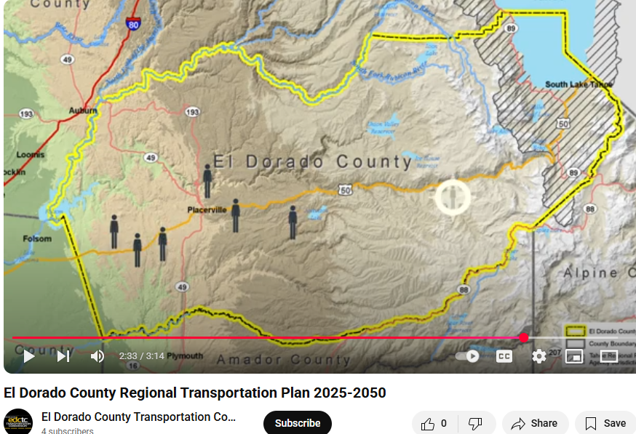
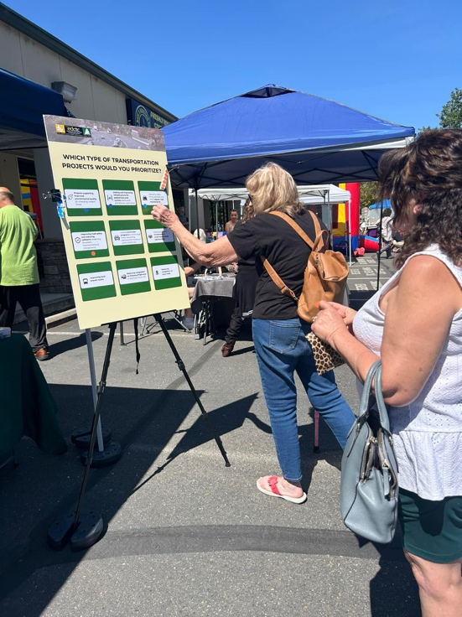
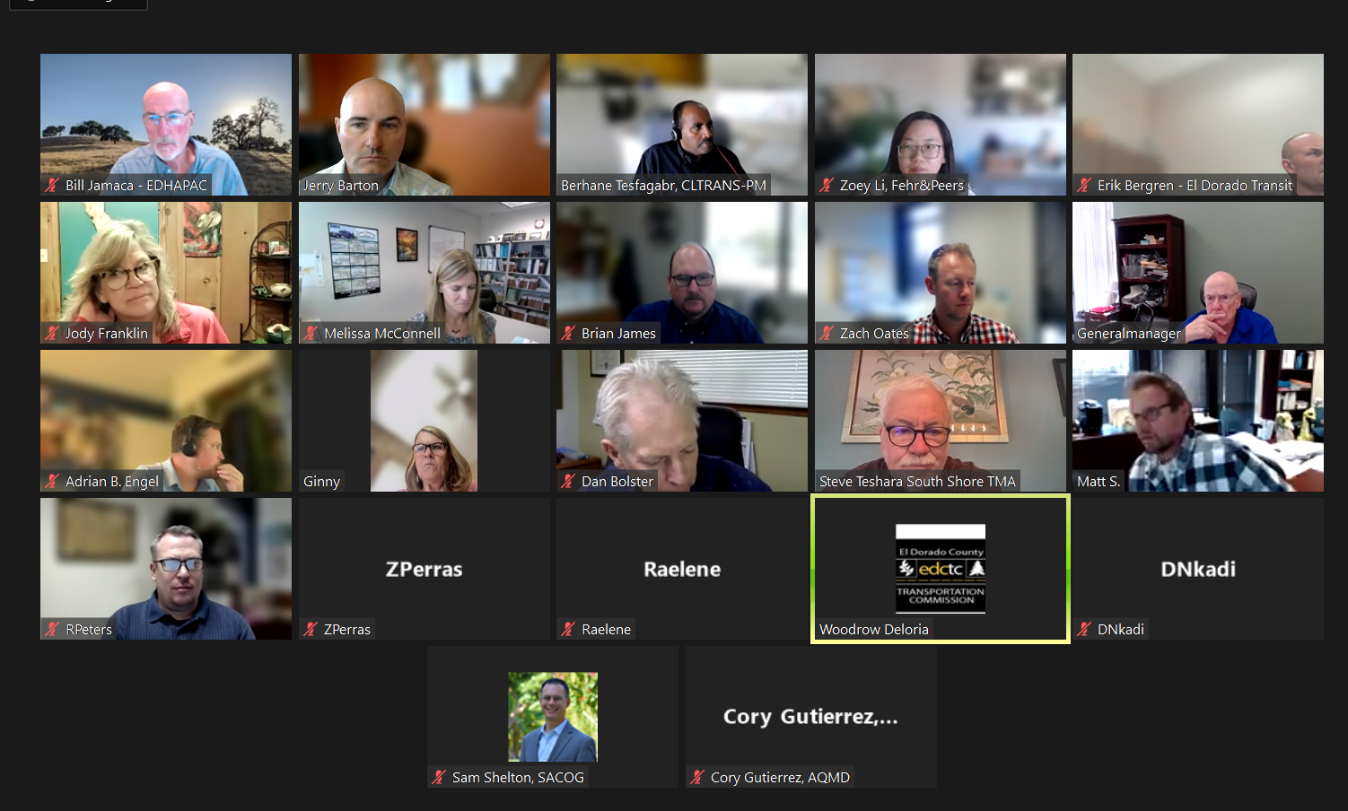
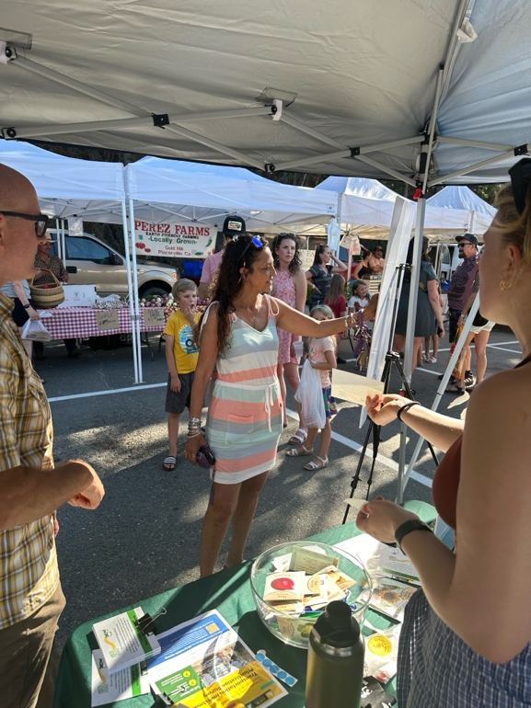
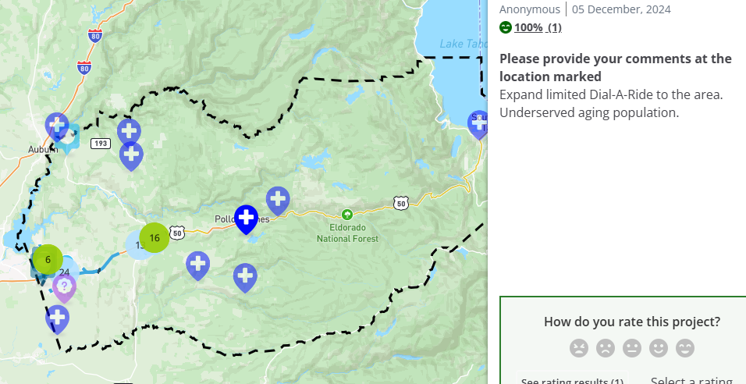
HOW DID WE GET HERE?
Pop Up Workshops, RTPAC Meetings and Social Pinpoint

Slide 5
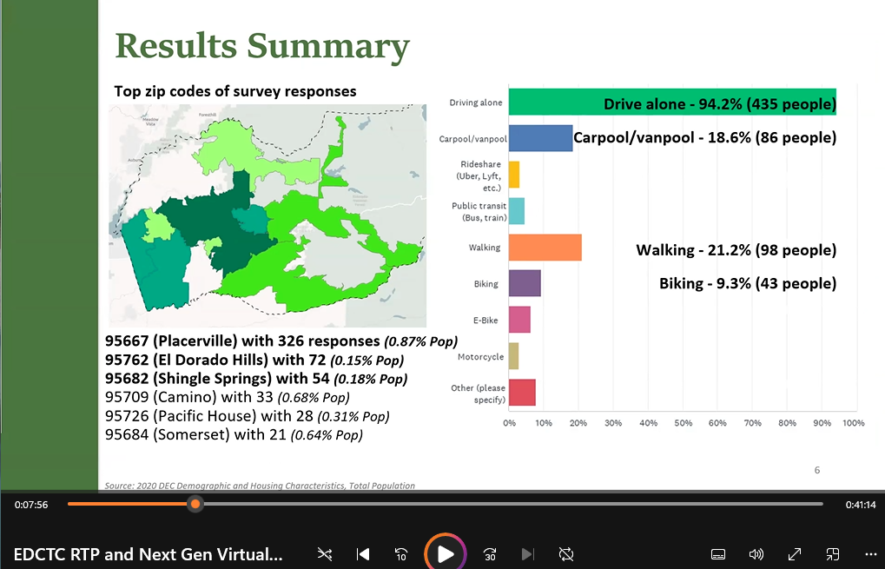
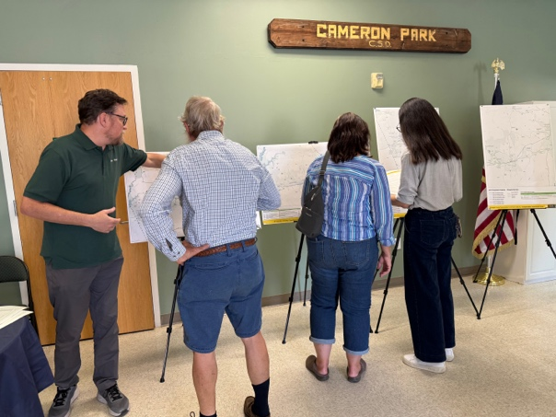
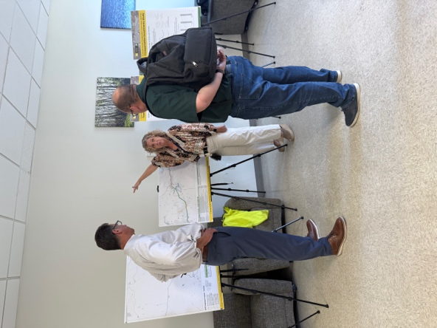
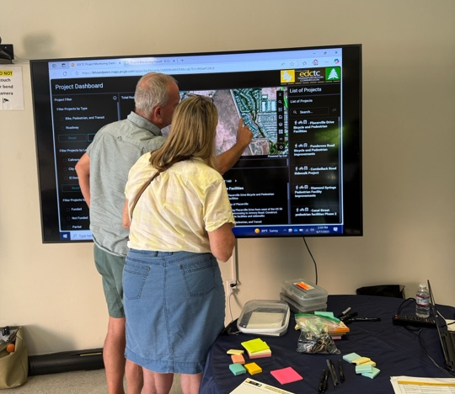
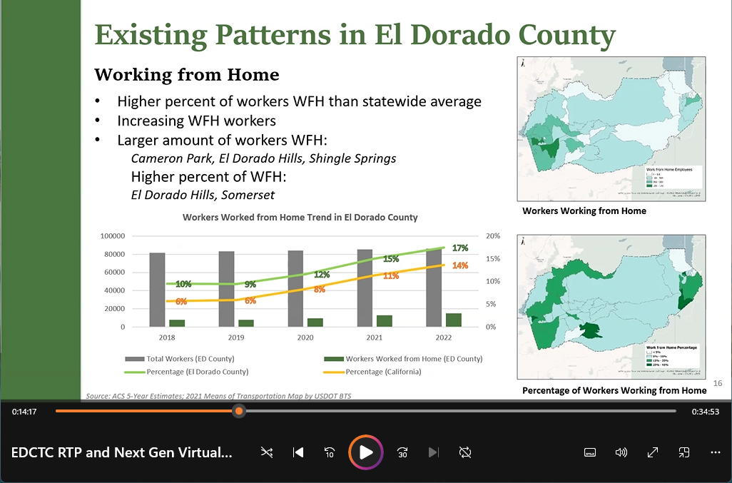
HOW DID WE GET HERE?
June 2025 Workshops in person and virtual

Slide 6

ABOUT NEXT GEN:
Projects are linked to RTP Goals
Projects are consistent with Regional, State, and Federal objectives and RTP Guidelines
Comprehensive Performance Metrics have been developed to identify projects that support RTP Goals
New Online Project Monitoring and Mapping Platform

Slide 7
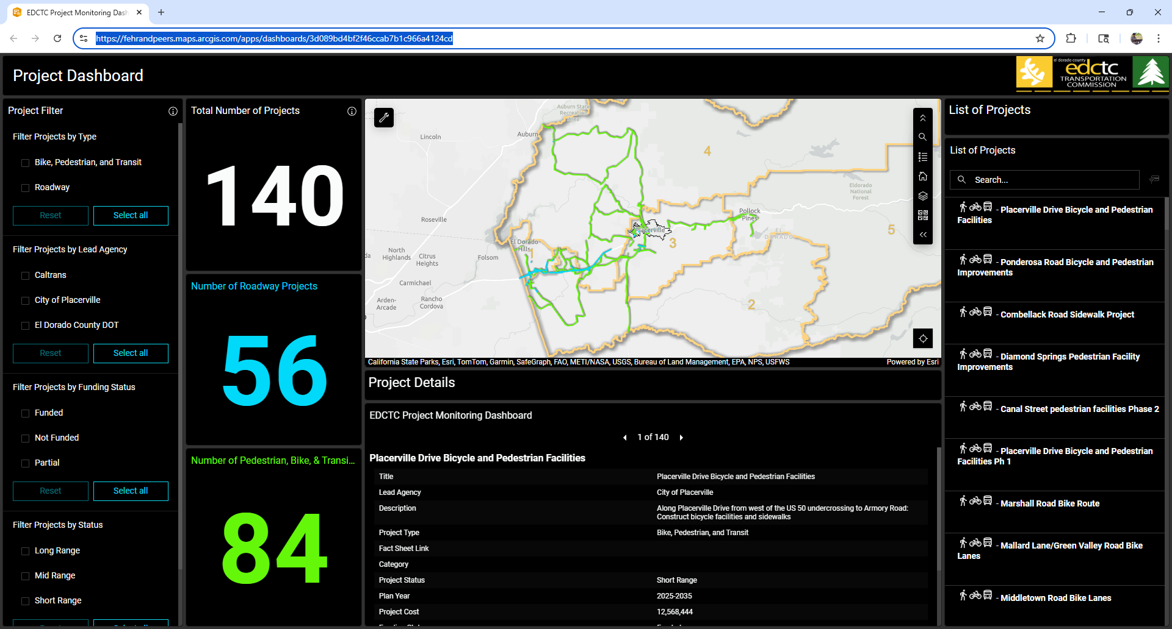
PROJECT MAPPING PLATFORM

Slide 8
CHAPTER 6 - INTEGRATED REGIONAL TRANSPORTATION PLANNING
GOAL 1
Integrate land use, air quality, and public engagement into regional transportation planning and project delivery to better serve the users, enhance the economy, and preserve the environment, quality of life, and community character.

Slide 9
CHAPTER 6 - INTEGRATED REGIONAL TRANSPORTATION PLANNING
PARTIAL LIST OF PROPOSED PROJECTS AND PERFORMANCE MEASURE CONSISTENCY (SEE APPENDIX 2A FOR COMPREHENSIVE LIST) |  |  |  |  |  | GOAL 1: INTEGRATED REGIONAL TRANSPORTATION PLANNING
 |  |  |  |  |  | Proposed Project Performance Criteria
 |  |  |  |  |  | 1.1 Project is consistent with the General Plan (GP) of El Dorado County or the City of Placerville, as well as Caltrans corridor plans. |  | 1.2 Project directly supports known regional economic generators (utilizing Zartico data to summarize and visually depict major economic generators on a map). |  | 1.2 Project directly supports known regional economic generators (utilizing Zartico data to summarize and visually depict major economic generators on a map).
 |  |  |  |  |  | Performance Reference*
Lead Agency | Year | Map ID | Project Category | Title | Description | M1 | M2 |  | M3 | M4
El Dorado County | Beyond 2045 | 11 | G- System Management, Operations, and ITS | Auxiliary Lane Project: WB Latrobe Rd/ ED Hills Blvd | Add auxiliary lane (lane between ramps of adjacent interchanges) from WB Latrobe Rd/ ED Hills Blvd to Empire Ranch | Yes | No |  | Yes | No
City of Placerville | 2025-2035 | 8 | B- Road & Highway Capacity | Western Placerville Interchanges Phase 3 | Replacement and widening of the Placerville Dr/US 50 Overcrossing with upgraded on and offramps and an EB auxiliary lane (lane between ramps of adjacent interchanges) between the Placerville Dr and Ray Lawyer Dr on/off ramps | Yes | Yes |  | Yes | Yes
*Performance Reference:
M1: Mobility section maps in El Dorado County General Plan
M2: Mobility section maps in the City of Placerville General Plan
M3: Caltrans corridor plan map
M4: Economic generators

Slide 10
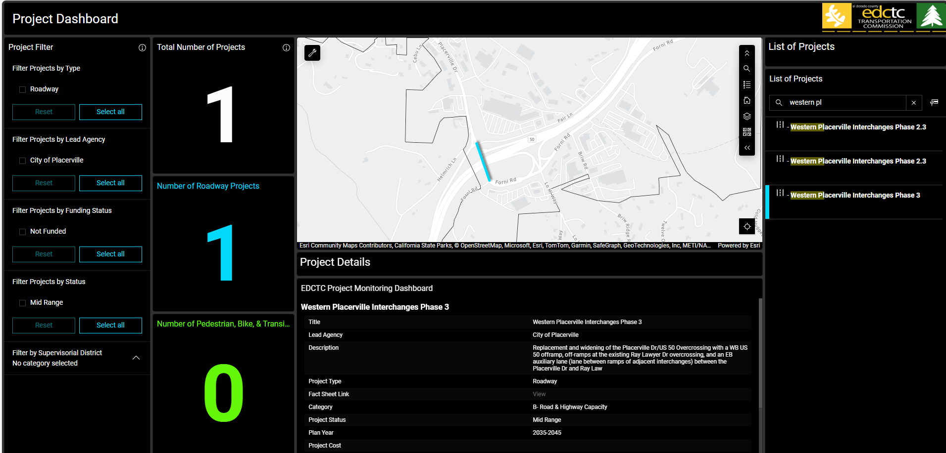
CHAPTER 6 - Goal 1 - INTEGRATED REGIONAL TRANSPORTATION PLANNING

Slide 11
CHAPTER 7 -SUSTAINABLE, ADAPTABLE, RESILIENT
GOAL 2
Implement regional transportation investments which provide context sensitive options, embrace emerging technologies, and greatly improve accessibility, adaptability, mobility, and climate emergency preparedness.

Slide 12
CHAPTER 7 – SUSTAINABLE, ADAPTABLE, RESILIENT
PARTIAL LIST OF PROPOSED PROJECTS AND PERFORMANCE MEASURE CONSISTENCY (SEE APPENDIX 2A FOR COMPREHENSIVE LIST) |  |  |  |  |  | GOAL 2: SUSTAINABLE, ADAPTABLE, RESILIENT
 |  |  |  |  |  | Proposed Project Performance Criteria
 |  |  |  |  |  | 2.1 Project is identified within the Wildfire Preparedness Study or Local Road Safety Plan (LRSP). | 2.2 Project located within areas falling below average VMT thresholds established under SB 743 guidelines. |  | 2.3 Project facilitating electrification through the installation of charging infrastructure. | 2.3 Project facilitating electrification through the installation of charging infrastructure.
 |  |  |  |  |  | Performance Reference*
Lead Agency | Year | MapID | Project Type Category | Title | Description | M5 | M6 | M7 |  | M8
City of Placerville | 2025-2035 | 41 | G- System Management, Operations, and ITS | US 50 Trip to Green Congestion Management and Resiliency Strategy | Along US 50 and at each of the three signalized intersections between Canal St and Bedford Ave, install intelligent transportation systems, barriers, and advanced warning signals to notify the motoring public when signals are held in a solid green phase. | Yes | No | Above Average |  | Yes
City of Placerville | 2025-2035 | 43 | G- System Management, Operations, and ITS | Clay St/ Hangtown Creek Bridge and Cedar Ravine Intersection Improvements | Clay St. over Hangtown Creek, 150' north of Main Street: Replace 1 lane bridge with 2 lane bridge. Realign Clay St with Cedar Ravine and create a four way stop intersection. | Yes | No | Below Average |  | No
El Dorado County | 2035-2045 | 39 | B- Road & Highway Capacity | US 50/Silva Valley Pkwy Interchange - Phase 2 | Final phase of US 50/Silva Valley Pkwy Interchange. Due to future growth in the area this project will be necessary to accommodate traffic projected for 2030. | No | No | Below Average |  | No
*Performance Reference:
M5: Evacuation Plan
M6: Local Road Safety Plan Map
M7: VMT Screening Map
M8: EV Charging Station Map

Slide 13
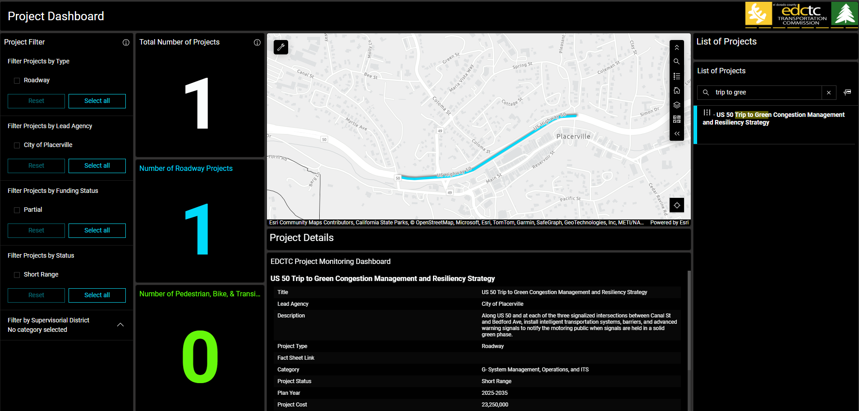
CHAPTER 7 - Goal 2 - SUSTAINABLE, ADAPTABLE, RESILIENT

Slide 14
CHAPTER 8 -SURFACE TRANSPORTATION SYSTEM
GOAL 3
Optimize the existing highways, streets, and roads to enhance maintenance and operations, provide necessary capacity, and improve safety for all users.

Slide 15
CHAPTER 8 - Goal 3 – SURFACE TRANSPORTATION SYSTEM
PARTIAL LIST OF PROPOSED PROJECTS AND PERFORMANCE MEASURE CONSISTENCY (SEE APPENDIX 2A FOR COMPREHENSIVE LIST) |  |  |  |  |  | GOAL 3: SURFACE TRANSPORTATION SYSTEM
 |  |  |  |  |  | Proposed Project Performance Criteria
 |  |  |  |  |  | 3.1 Fix it first – Project focuses on maintenance or remediation of existing infrastructure deficiencies (new roadways would not qualify). | 3.2 Optimization of interchanges.
 |  |  |  |  |  | Performance Reference*
Lead Agency | Year | MapID | Project Type Category | Title | Description
El Dorado County | 2025-2035 | 35 | B- Road & Highway Capacity | US 50/El Dorado Hills Blvd Interchange Phase 2B - Eastbound Ramps | Realign approx. 1/4 mile of Durock Rd to South Shingle Road/Sunset Ln and signalize new intersection. Durock Rd will be two through lanes with turn pockets at the intersection. | No | Yes
El Dorado County | 2025-2035 | 36 | B- Road & Highway Capacity | US 50/ Ponderosa Rd Durock Rd/So. Shingle Rd Interchange Improvements | Includes construction of the first phase to realign approximately ¼ mile of Durock Rd to South Shingle Rd/Sunset Ln and signalize the new intersection. Durock Rd will be two through lanes with turn pockets at the intersection. The first phase will also realign approx. ¼ mile of N. Shingle Rd about 600ft. north at Ponderosa Rd; realign the WB off-ramp to align with Wild Chaparral Dr. and signalize the new intersection. Realigned N. Shingle Rd will be two through lanes with turn pockets at the intersection. | No | Yes
*Performance Reference:
None

Slide 16
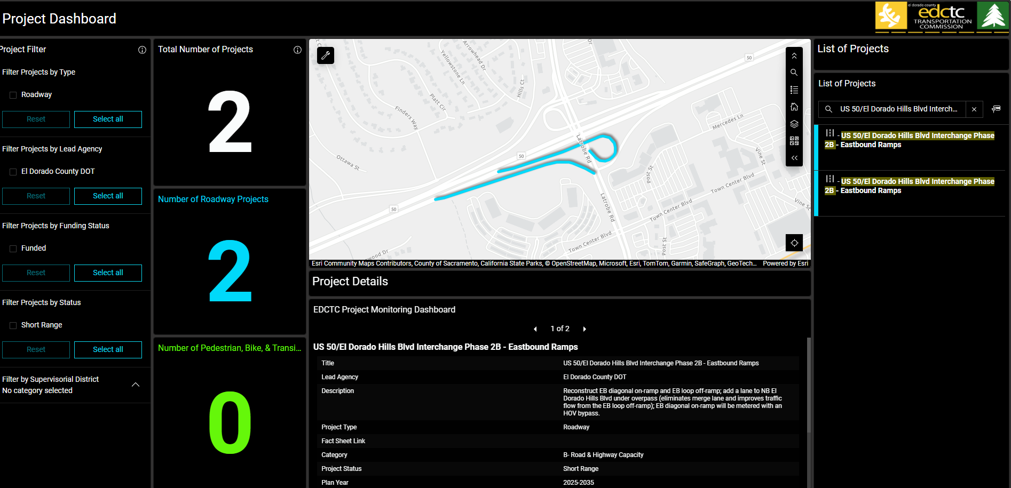
CHAPTER 8 - Goal 3 - SURFACE TRANSPORTATION SYSTEM

Slide 17
CHAPTER 9 - PUBLIC TRANSIT
GOAL 4
Promote a safe, welcoming, innovative, sustainable, and reliable public transit system which is accessible to and provides effective transport across the diverse geography of the region.

Slide 18
CHAPTER 9 - Goal 4 – PUBLIC TRANSIT
PARTIAL LIST OF PROPOSED PROJECTS AND PERFORMANCE MEASURE CONSISTENCY (SEE APPENDIX 2A FOR COMPREHENSIVE LIST) |  |  |  |  |  | GOAL 4: PUBLIC TRANSIT
 |  |  |  |  |  | Proposed Project Performance Criteria
 |  |  |  |  |  | 4.1 Project is included in El Dorado Transit’s short – or long-range transit plans. | 4.2 Fleet electrification
 |  |  |  |  |  | Performance Reference*
Lead Agency | Year | MapID | Project Type Category | Title | Description | M9 | N/A
El Dorado Transit | 2025-2035 | 295 | Transit | Microtransit Weekdays | Provide a weekday microtransit demonstration project from 7:30 a.m. to 5:00 p.m. at a service area TBD. | Yes | No
El Dorado Transit | 2025-2035 | 301 | Transit | El Dorado Hills Park and Ride Improvements | Repave existing lot, construct passenger plaza, renew landscaping, striping and signing, add new EV charging stations, improve bicycle and pedestrian connections, purchase and improve the lot east of the existing facility. | Yes | No
*Performance Reference:
M9: Western El Dorado County 2019 Short- and Long-Range Transit Plan

Slide 19
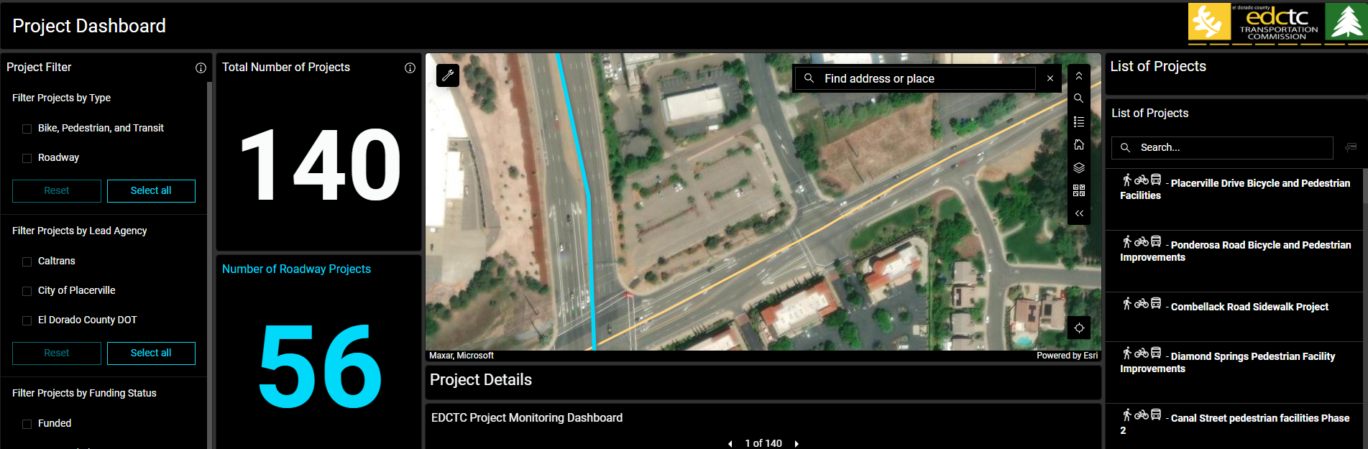
CHAPTER 9- Goal 4 -PUBLIC TRANSIT

Slide 20
CHAPTER 10 - AVIATION
GOAL 5
Promote and preserve aviation facilities and services that complement the regional transportation system and support critical emergency response.

Slide 21
CHAPTER 10 - Goal 5 – AVIATION
PARTIAL LIST OF PROPOSED PROJECTS AND PERFORMANCE MEASURE CONSISTENCY (SEE APPENDIX 2A FOR COMPREHENSIVE LIST) |  |  |  |  |  | GOAL 5: AVIATION
 |  |  |  |  |  | Proposed Project Performance Criteria
 |  |  |  |  |  | 5.1 Projects that improve access to (Georgetown and Placerville) airport (subjective evaluation).
 |  |  |  |  |  | Performance Reference*
Lead Agency | Year | MapID | Project Type Category | Title | Description | M10
City of Placerville | 2025-2035 | 7 | G- System Management, Operations, and ITS | US 50 Broadway Eastbound Exit (#47)-Signalization and ramp lengthening | Lengthen eastbound exit ramp of US 50 at Broadway (#47) and install traffic signal. | Yes
El Dorado County | 2035-2045 | 34 | B- Road & Highway Capacity | US 50/Cameron Park Dr Interchange Improvements | This project includes study to identify capacity improvements alternatives and selection of preferred alternative; assumes reconstruction of existing US50 bridges to widen Cameron Park Dr to 8 lanes under the overcrossing; road and ramp widenings. | Yes
*Performance Reference:
M10: El Dorado County Airport Land Use Compatibility Plan

Slide 22
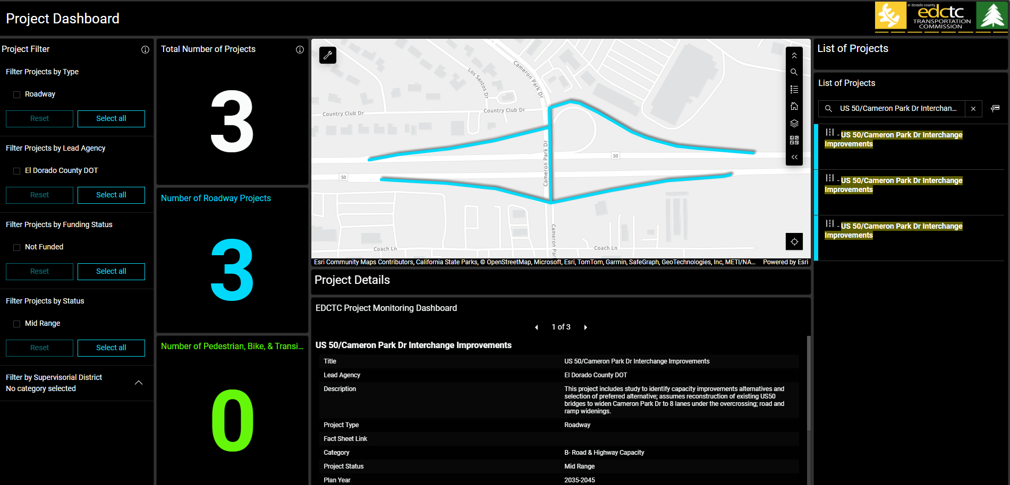
CHAPTER 10 - Goal 5 - AVIATION

Slide 23
CHAPTER 11 - ACTIVE TRANSPORTATION
GOAL 6
Complete and maintain a safe, convenient, and connected active transportation system for all users.

Slide 24
CHAPTER 11 - Goal 6 – ACTIVE TRANSPORTATION
PARTIAL LIST OF PROPOSED PROJECTS AND PERFORMANCE MEASURE CONSISTENCY (SEE APPENDIX 2A FOR COMPREHENSIVE LIST) |  |  |  |  |  | GOAL 5: AVIATION
 |  |  |  |  |  | Proposed Project Performance Criteria
 |  |  |  |  |  | 6.1 Projects are identified in Active Transportation Plans (ATPs) | 6.2 Project is consistent with SACOG’s Regional Trails Plan | 6.3 Project is consistent with the US 50 Corridor Bike Route
 |  |  |  |  |  | Performance Reference*
Lead Agency | Year | MapID | Project Type Category | Title | Description | M11 | M12 | M13
 |  |  |  |  |  | If the project was along an improved sidewalk, bike lanes, or trails category in the ATP map we marked it "Yes." If not, we marked it "No." | "Yes" was marked for projects that connected to or improved a trail in the SACOG regional trail network; otherwise, "No" was marked. | "Yes" was selected for projects on improved bike routes along the US 50 corridor; otherwise, "No" was selected.
El Dorado County DOT | 2025-2035 | 231 | A- Bike & Ped | Shingle Springs El Dorado Trail Class I Improvements | On the Sacramento-Placerville Transportation Corridor from Shingle Springs Dr to South Shingle Rd: Construct El Dorado Trail Class I multi-use bicycle and pedestrian path | Yes | Yes | Yes
El Dorado County DOT | 2025-2035 | 215 | A- Bike & Ped | La Canada Dr and Gateway Dr Pedestrian/ Bicycle Improvements | Along segments of Parkdale Ln, Gateway Dr, Cambridge Rd, La Canada Dr, and Cameron Park Dr: Construct new sidewalk, bike lanes, two crosswalks, install four solar flashing beacons, and replace or upgrade curbs, ramps, and gutters. | Yes | No | Yes
*Performance Reference:
M11: Included in the ATP Map
M12: Included in the SACOG Regional Trails Plan Map
M13: Included in the US 50 Corridor Bike Route Map

Slide 25
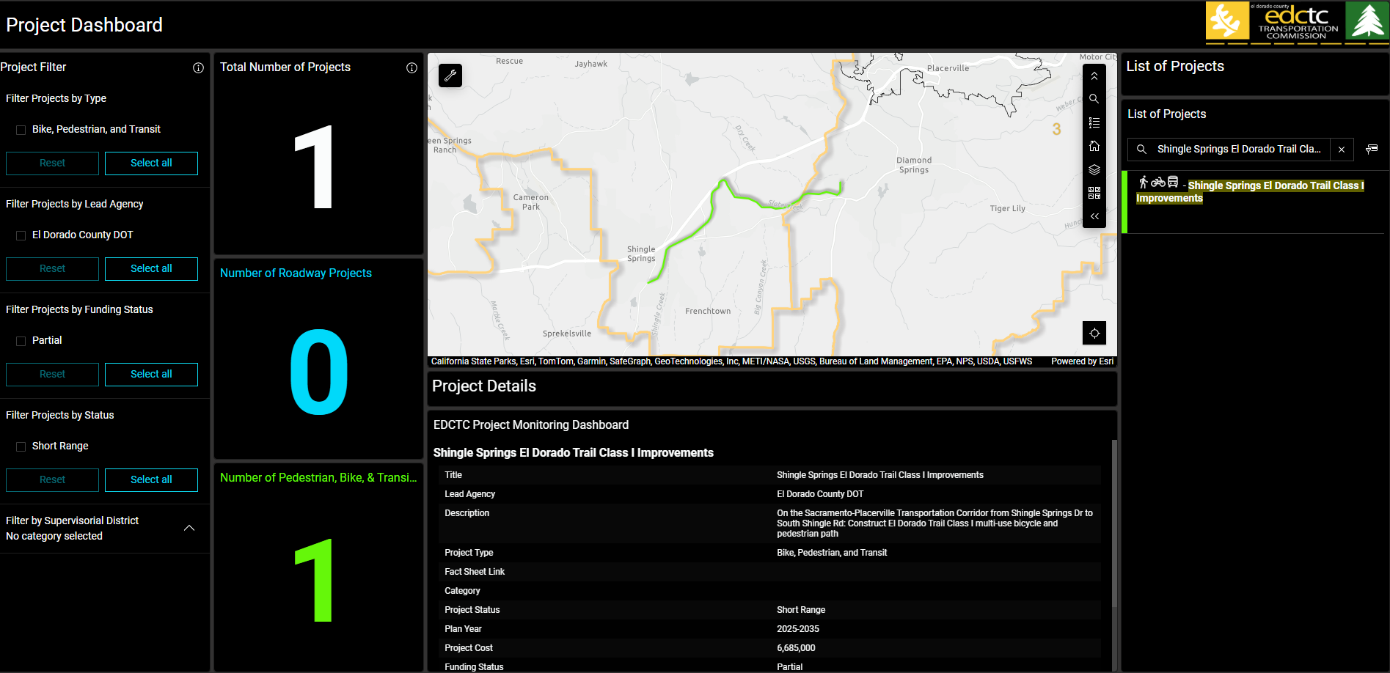
CHAPTER 11 - Goal 6 – ACTIVE TRANSPORTATION

Slide 26
CHAPTER 12 - TRANSPORTATION SYSTEMS MANAGEMENT
GOAL 7
Develop and support an integrated transportation system that incorporates multi-modal corridor management solutions and public awareness of mobility options to limit vehicle miles travelled and maximize throughput.

Slide 27
CHAPTER 12 - Goal 7 – TRANSPORTATION SYSTEMS MANAGEMENT
PARTIAL LIST OF PROPOSED PROJECTS AND PERFORMANCE MEASURE CONSISTENCY (SEE APPENDIX 2A FOR COMPREHENSIVE LIST) |  |  |  |  |  | GOAL 5: AVIATION
 |  |  |  |  |  | Proposed Project Performance Criteria
 |  |  |  |  |  | 7.1 Project is Included in TDM programs. | 7.2 Project focuses on system enhancement related to ITS or signal upgrades. | 7.3 Optimization of existing intersections.
 |  |  |  |  |  | Performance Reference*
Lead Agency | Year | MapID | Project Type Category | Title | Description | M11 | M12 | M13
El Dorado County | 2025-2035 | 19 | G- System Management, Operations, and ITS | El Dorado Hills ITS | ITS technology implementation along major signalized corridors in the El Dorado Hills area, including El Dorado Hills Blvd, Latrobe Rd, White Rock Rd, and Silva Valley Pkwy | No | Yes | Yes
El Dorado County | 2025-2035 | 24 | G- System Management, Operations, and ITS | Bridlewood/ Bass Lake Rd Roundabout | The project will construct a single-lane roundabout at the intersection of Bass Lake Rd and Bridlewood Dr | No | Yes | Yes
*Performance Reference:
None

Slide 28
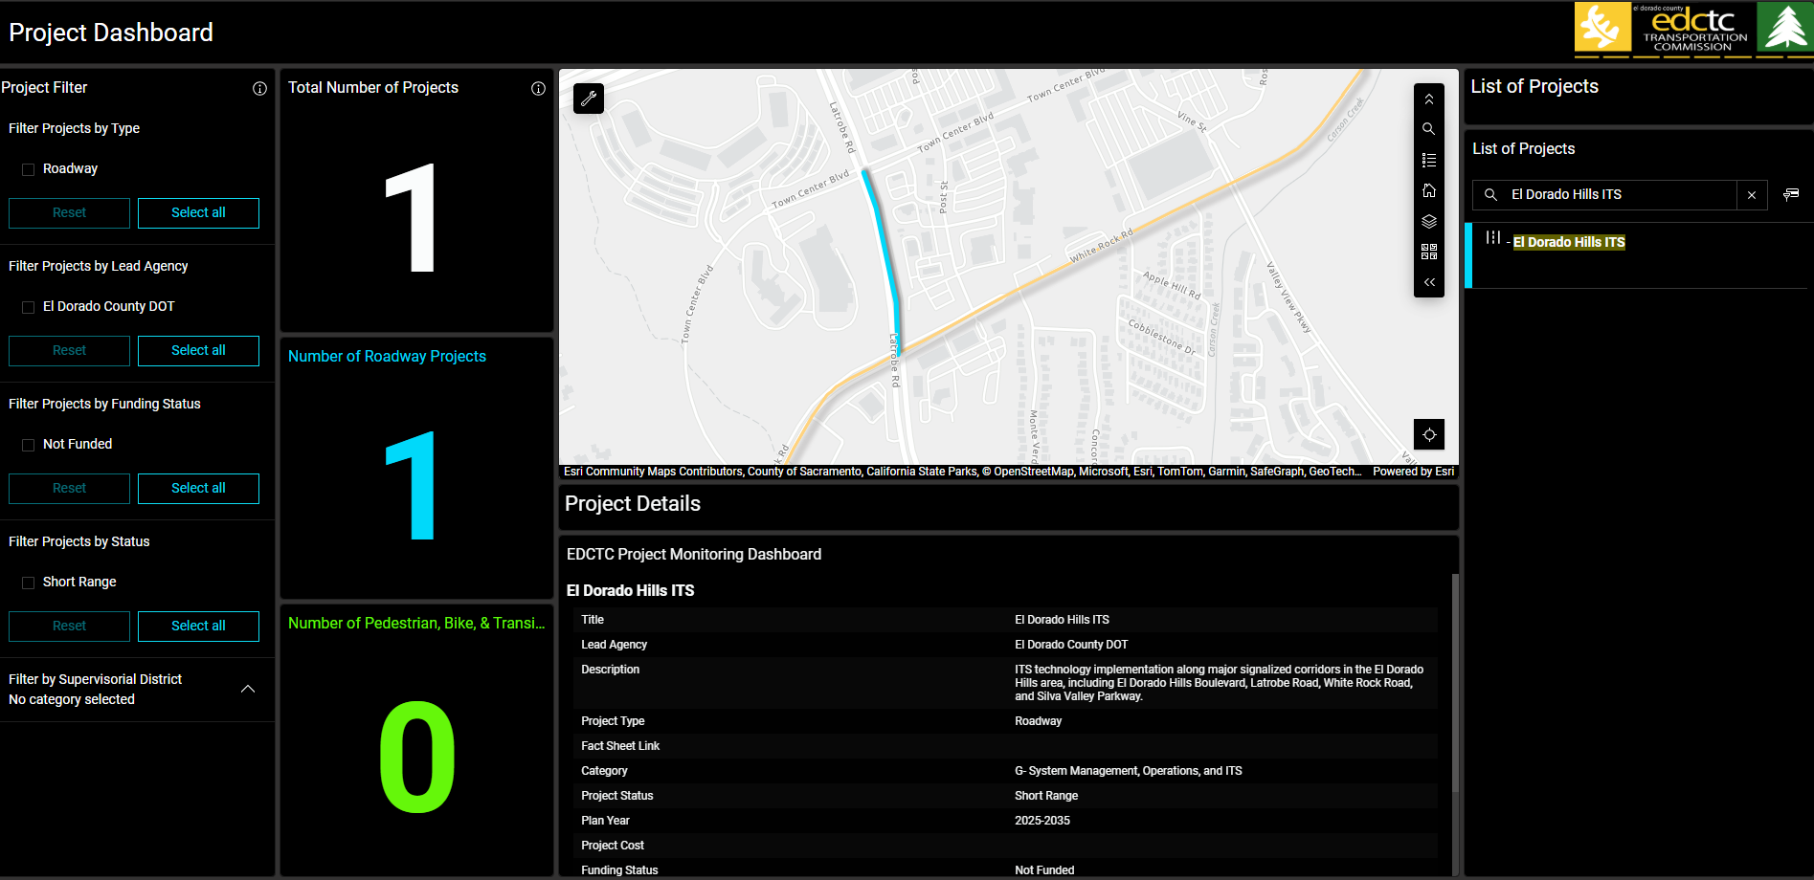
CHAPTER 12 - Goal 7 - TRANSPORTATION SYSTEMS MANAGEMENT

Slide 29
CHAPTER 13 REGIONAL
EQUITY AND COLLABORATION
GOAL 8
Engage in inclusive regional transportation planning advancing equity through meaningful transportation investments to empower the historically underserved.

Slide 30
CHAPTER 13 - Goal 8 – REGIONAL EQUITY AND COLLABORATION
PARTIAL LIST OF PROPOSED PROJECTS AND PERFORMANCE MEASURE CONSISTENCY (SEE APPENDIX 2A FOR COMPREHENSIVE LIST) |  |  |  |  |  | GOAL 8: REGIONAL EQUITY AND COLLABORATION
 |  |  |  |  |  | Proposed Project Performance Criteria
 |  |  |  |  |  | 7.1 Project is Included in TDM programs. | 7.2 Project focuses on system enhancement related to ITS or signal upgrades. | 7.3 Optimization of existing intersections.
 |  |  |  |  |  | Performance Reference*
Lead Agency | Year | MapID | Project Type Category | Title | Description | M11 | M12 | M13
El Dorado County | 2025-2035 | 209 | A- Bike & Ped | Diamond Springs Pedestrian Facility Improvements | Pleasant Valley Rd between Pearl Place and SR 49, Pearl Place, Racquet Wy, Wimbledon Dr, and Black Rice Rd. Install various bicycle and pedestrian facilities. | No | Yes | El Dorado County
City of Placerville | 2025-2035 | 205 | A- Bike & Ped | Placerville Dr Bicycle and Pedestrian Facilities | Along Placerville Dr between Cold Springs Rd and the Ray Lawyer Dr and Green Valley Rd from Placerville Dr to Mallard Ln: construct Class 2 and Class 4 bicycle facilities, sidewalks, crossing improvements, curb ramps, and transit improvements. | No | Yes | City of Placerville
El Dorado County | 2025-2035 | 23 | B- Road & Highway Capacity | Missouri Flat Rd Widening - China Garden Rd to Pleasant Valley Rd/SR49 | Widening of Missouri Flat Rd from China Garden to Pleasant Valley Rd/SR 49. Work includes widening the road to 4 lanes, sidewalk, curb, and gutter. | Yes | Yes | El Dorado County
*Performance Reference:
M14: Disadvantaged community maps from existing conditions report
M15: SACOG Equity Priority Communities Tool Map

Slide 31
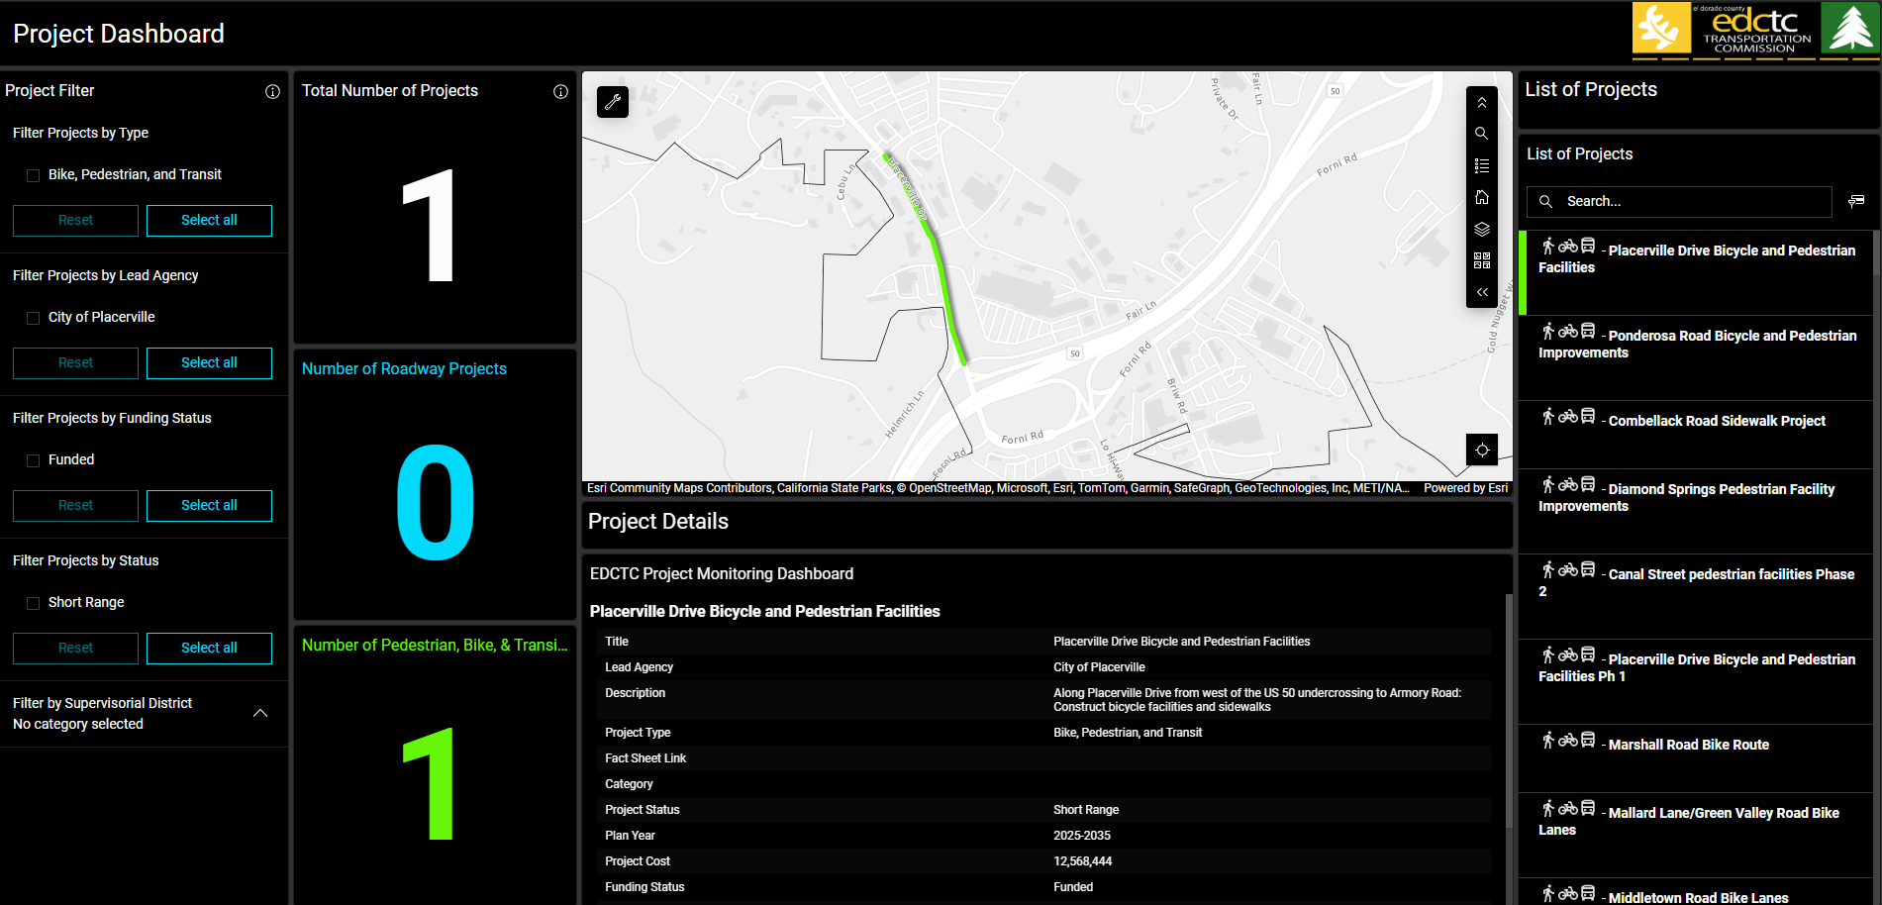
CHAPTER 13 - Goal 8 - REGIONAL EQUITY AND COLLABORATION

Slide 32
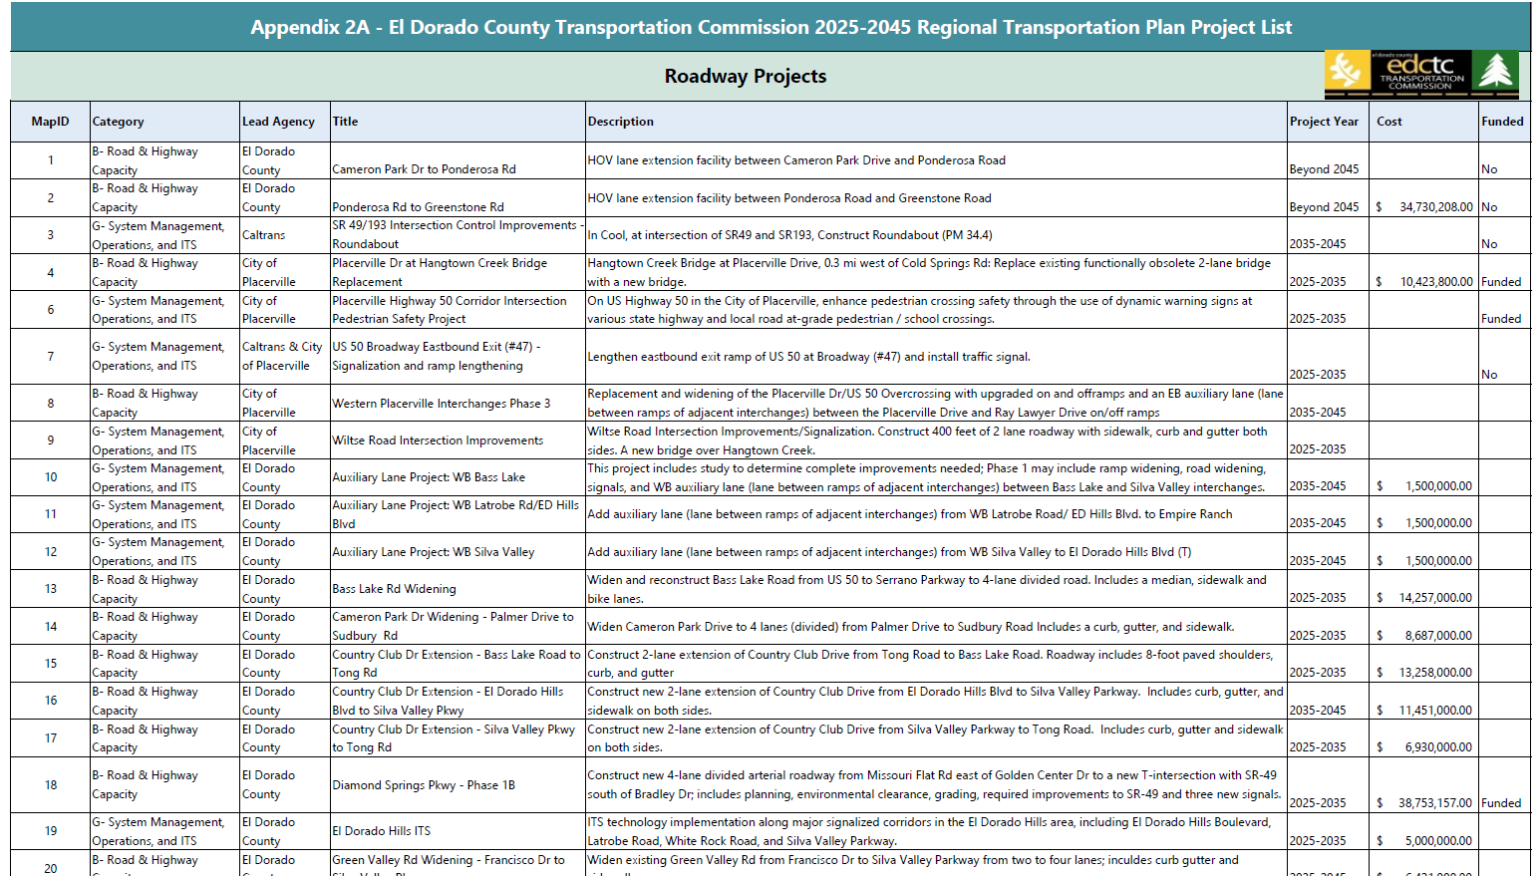
COMPREHENSIVE PROJECT LIST

Slide 33
WHAT WE ARE WORKING ON
Refining comprehensive project list
Sync project list to map
Respond to all public comments
Finalize Financial Element
Appendices upload (in progress)
Final EIR – after August 18

Slide 34
FINAL STEPS TO RTP 2025-2045 ADOPTION
DATE | MILESTONE
August 7, 2025 | Draft RTP Action Element and Project List Presented to EDCTC Board
August 15, 2025 | Draft Financial Element provided to RTP Advisory Committee members
August 18, 2025 | RTP Draft EIR Comment Deadline
August 31, 2025 | Draft Policy Element and Action Element Comment Deadline
September 3, 2025 | Draft Financial Element presented to EDCTC Board
September 3, 2025 | Completed RTP Checklist provided to EDCTC/Caltrans
September 15, 2025 | RTP Draft Financial Element Comment Deadline
November 6, 2025 | Anticipated Final 2025-2045 RTP and FINAL EIR Adoption

Slide 35
Action Element documents available online: https://www.edctc.org/regional-transportation-plan-2025-2045
QUESTIONS?

